Slide 1
8. Solar neutrinos and neutrinos from Gravitational Stellar collapse
Corso “Astrofisica delle particelle”
Prof. Maurizio Spurio
Università di Bologna. A.a. 2011/12

Slide 2
Outlook
Neutrino sources in the Sun
The Standard Solar Model
Experimental Techniques
The SNO experiment
Neutrinos from a Stellar Gravitational Collapse
The SN1987A

Slide 3
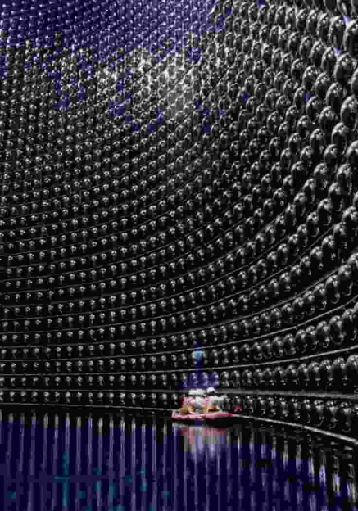
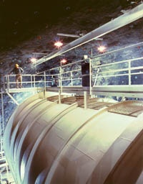
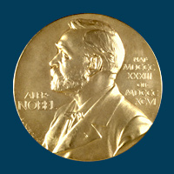
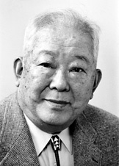

The 2002 Nobel Prize for the Solar Neutrino Physics
Masatoshi Koshiba
http://nobelprize.org/nobel_prizes/physics/laureates/2002/koshiba-lecture.pdf
Raymond Davis Jr.
http://nobelprize.org/nobel_prizes/physics/laureates/2002/davis-lecture.pdf

Slide 4
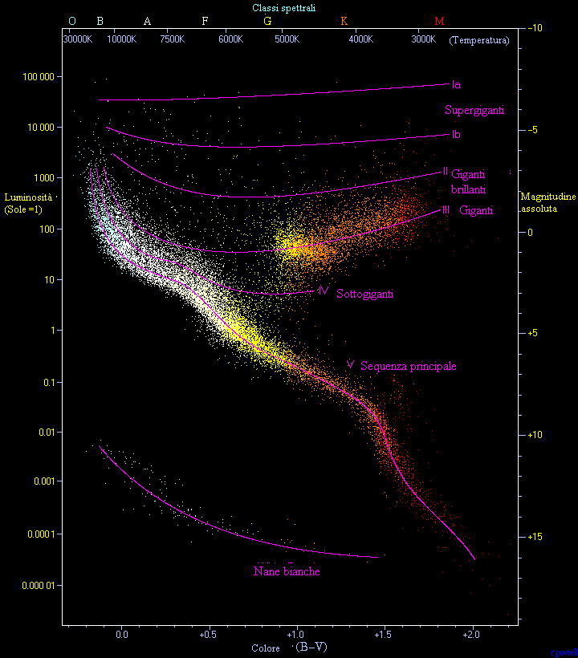
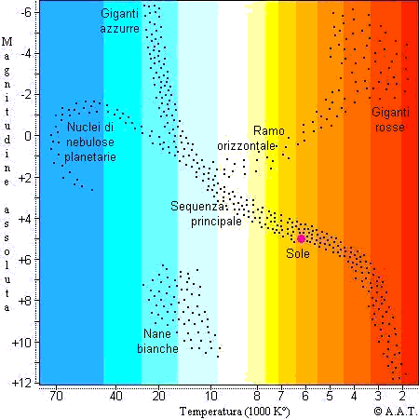
The HR diagram

Slide 5
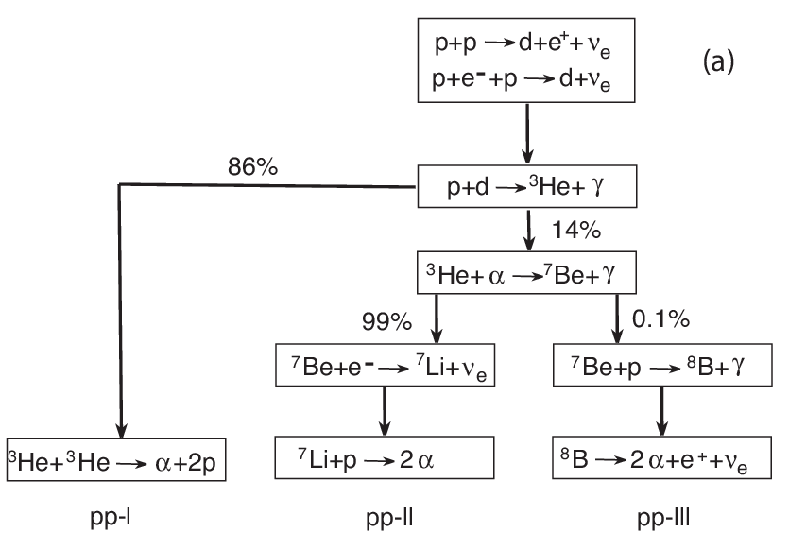
8.1 Neutrino sources in the Sun
Nuclear fusions reactions: The Proton cycle
E_{ν}<0.42 MeV
90% E_{ν}=0.86 MeV
10% E_{ν}=0.38 MeV
E_{ν}<14.06 MeV

Slide 6
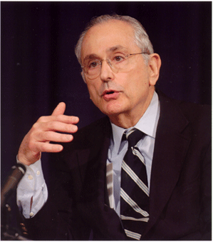
8.2 The Standard Solar Model
_{http://www.sns.ias.edu/~jnb/}
J. Bahcall: The main author of the SSM
The standard solar model is derived from the conservation laws and energy transport equations of physics, applied to a spherically symmetric gas (plasma) sphere and constrained by the luminosity, radius, age and composition of the Sun
_{John Bahcall}
_{1934–2005}
Inputs for the Standard Solar Model
  Mass
  Age
  Luminosity
  Radius
No free parameters
Tested by helioseismology
Fusion ⇒ neutrinos
Nota: Leggere l’articolo (tradotto anche in italiano)
http://www.sns.ias.edu/~jnb/Papers/Popular/Nobelmuseum/italianmystery.pdf

Slide 7
The predictions of the SSM
Most of the neutrinos produced in the sun come from the first step of the pp chain.
Their energy is so low (<0.425 MeV) → very difficult to detect.
A rare side branch of the pp chain produces the "boron-8" neutrinos with a maximum energy of roughly 15MeV
These are the easiest neutrinos to observe, because the neutrino cross section increases with energy.
A very rare interaction in the pp chain produces the "hep" neutrinos, the highest energy neutrinos produced in any detectable quantity by our sun.
All of the interactions described above produce neutrinos with a spectrum of energies. The inverse beta decay of Be⁷ produces mono-energetic neutrinos at either roughly 0.9 or 0.4 MeV.
SSM

Slide 8
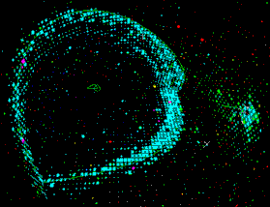
8.3 Experimental Techniques
Two detection techniques for the solar neutrinos:
1- elastic scattering
ν_{e} +e → ν_{e} +e
SK
2- Neutron capture ν_{e} +n → e +p
No free neutrons in nature:
(Z,A) + ν_{e} → e +(Z+1,A)
Example: ⁷¹Ga + ν → ⁷¹Ge + e
3- The SNO way:
  ν_{e} +d → e +p+p
  ν_{x} +d → ν_{x} +n+p

Slide 9
The 1st Solar ν Experiments
- ‘Davis’
- GALLEX/GNO < (radiochemical)
- SAGE
- SuperKamiokande (elastic sc.)
- SNO
The Clorine or ‘Davis’ experiment
³⁷Cl + ν_{e} → ³⁷Ar + e
Pioneering experiment by Ray Davis at Homestake mine began in 1967
Consisted of a 600 ton chlorine tank
Experiment was carried out over a 20 year period, in an attempt to measure the flux of neutrinos from the Sun
Measured flux was only one third the predicted value !!

Slide 10
The Solar Neutrino Problem (1980)
How can this deficit be explained?
The Sun’s reaction mechanisms are not fully understood
  NO! new measurements (~1998) of the sun resonant cavity frequencies
The experiment is wrong –
NO! All the fourthcoming new experiments confirmed the deficit!
Something happens to the neutrino as it travels from the Sun to the Earth
  YES! Oscillations of electron neutrinos!

Slide 11
Radiochemical experiments:
GALLEX/GNO and SAGE
The main solar neutrino source is from the p-p reaction:
p + p → d + e⁺ + ν_{e} + 0.42MeV
Solar neutrino experiment based on the reaction:
⁷¹Ga + ν_{e} → ⁷¹Ge + e⁻
Ability to detect the low-energy neutrinos from p-p fusion
SAGE: Located at the Baksan Neutrino Observatory in the northern Caucasus mountains of Russia (1990-2000)
GALLEX/GNO: Located at the Gran Sasso
Energy threshold: 233.2 ± 0.5 keV, below that of the p-p ν_{e} (420 keV)

Slide 12
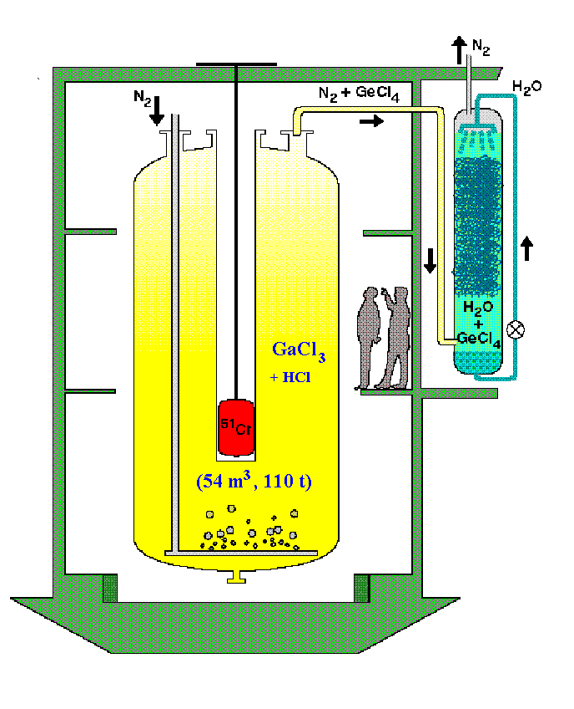
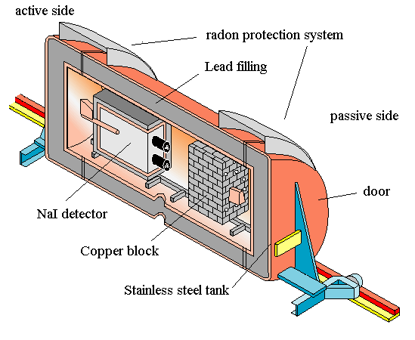
GALLEX/GNO
30.3 tons of gallium in form of a concentrated GaCl₃-HCl solution exposed to solar ν’s
Neutrino induced ⁷¹Ge forms the volatile compound GeCl₄
Nitrogen gas stream sweeps GeCl₄ out of solution
GeCl₄ is absorbed in water GeCl₄ → GeH₄ and introduced into a proportional counter
Number of ⁷¹Ge atoms evaluated by their radioactive decay

Slide 13
SAGE – Russian American Gallium Experiment
radiochemical Ga experiment at Baksan Neutrino Observatory with 50 tons of metallic gallium
running since 1990-present
latest result from 157 runs (1990-2006)
measures pp solar flux in agreement with SSM when oscillations are
included – the predicted signal is

Slide 14
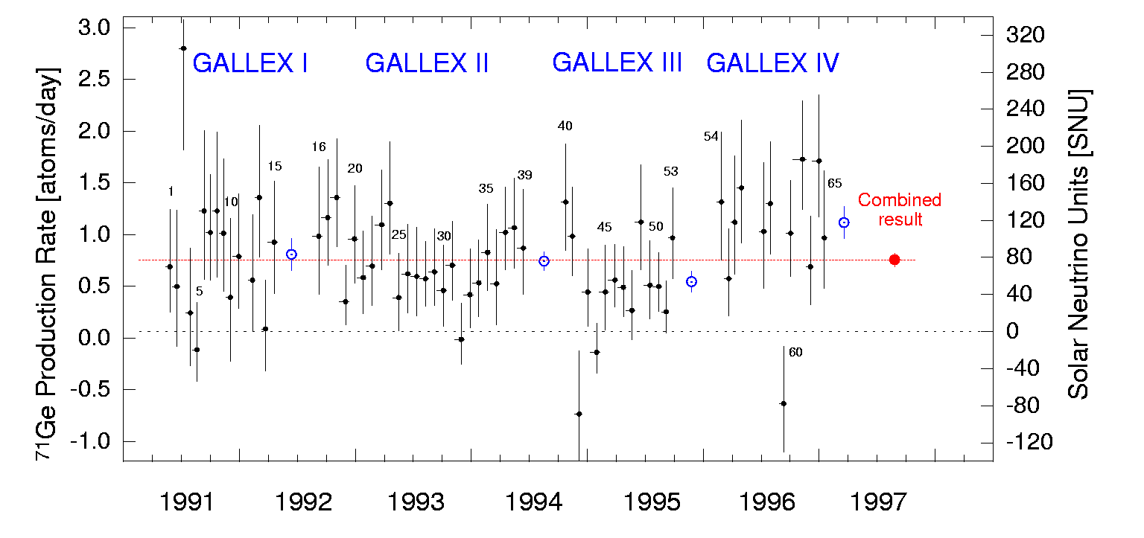
GALLEX-SAGE results
 | GALLEX+GNO (SNU) | SAGE (SNU)
Measured | 71 ± 5 | 66 ± 5
Expected | 128 ± 8 | 128 ± 8
SNU= 10⁻³⁶ (interactions/s · nucleus)

Slide 15
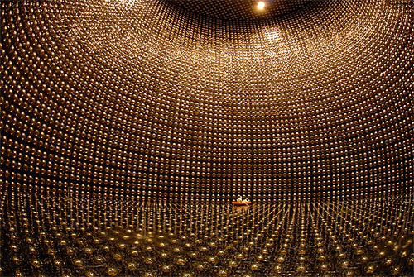
The SK way- The elastic scattering of neutrinos on electrons
Real-time detector
Elastic scattering
νe→ νe
ν_{e}
e

Slide 16
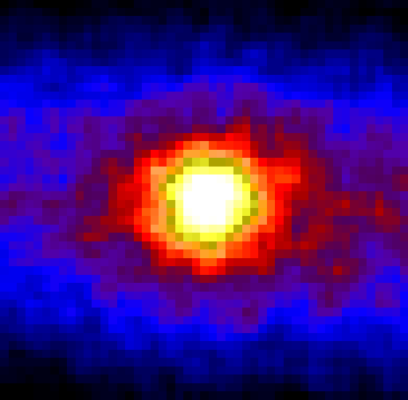
Neutrino Picture of the Sun
Sun direction
from SK
Radioactivity Background
SK measured a flux of solar neutrinos with energy > 5 MeV (from B⁸) about 40% of that predicted by the SSM
The reduction is almost constant up to 18 MeV
SK-III still running to lower the threshold, increase statistics and reduce systematic errors
Ratio of observed electron energy spectrum and expectation from SSM

Slide 17
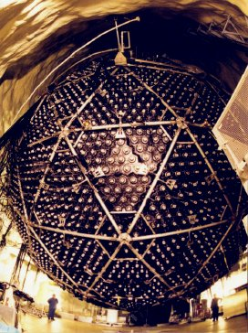
8.4 The decisive results: SNO (α:1999 –Ω:2006)
18m sphere, situated underground at about 2.5km underground, in Ontario
10,000 photomultiplier tubes (PMT)
Each PMT collect Cherenkov light photons
Heavy water (D₂O) inside a transparent acrylic sphere (12m diameter)
Pure salt is added to increase sensitivity of NC reactions (2002)
It can measure the flux of all neutrinos ‘Φ(ν_{x})’ and electron neutrinos ‘Φ(ν_{e})’
The flux of non-electron neutrinos
Φ(ν_{μ}, ν_{τ}) = Φ(ν_{x}) - Φ(ν_{e})
These fluxes can be measured via the 3 different ways in which neutrinos interact with heavy water

Slide 18
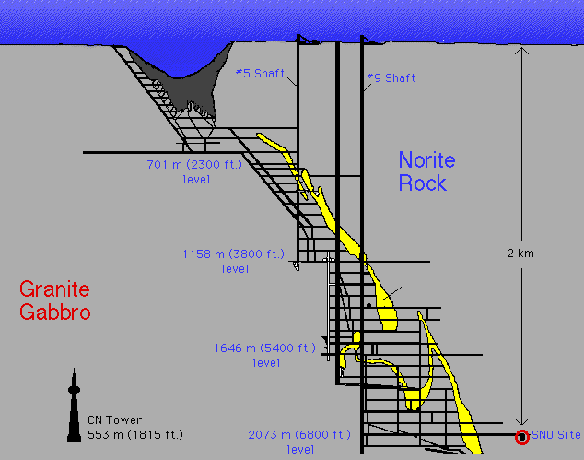
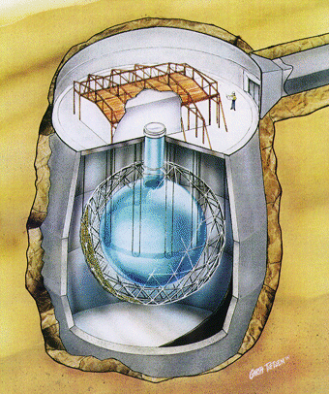
Sudbury Neutrino Observatory
1000 tonnes D₂O
Support Structure for 9500 PMTs, 60% coverage
12 m Diameter Acrylic Vessel
1700 tonnes Inner
Shielding H₂O
5300 tonnes Outer
Shield H₂O
Urylon Liner and
Radon Seal

Slide 19
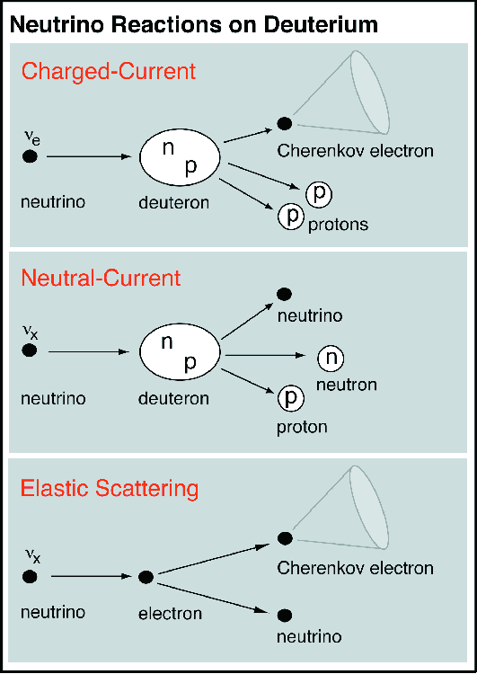
Reactions in SNO
CC
ν
+
d
⇒
p
+
p
+
e
-
e
  Gives ν_{e} energy spectrum well
  Weak direction sensitivity ∝ 1-1/3cos(θ)
  ν_{e} only.
  SSM: 30 CC events day⁻¹
NC
ν
+
d
⇒
p
+
n
+
ν
x
x
  - Measure total ⁸B ν flux from the sun.
  Equal cross section for all ν types
  SSM: 30/day
ES
ν
+
e
-
⇒
ν
+
e
-
x
x
  Low Statistics (3/day)
  Mainly sensitive to ν_{e,}, some
    sensitivity to ν_{μ} and ν_{τ}
  Strong direction sensitivity

Slide 20
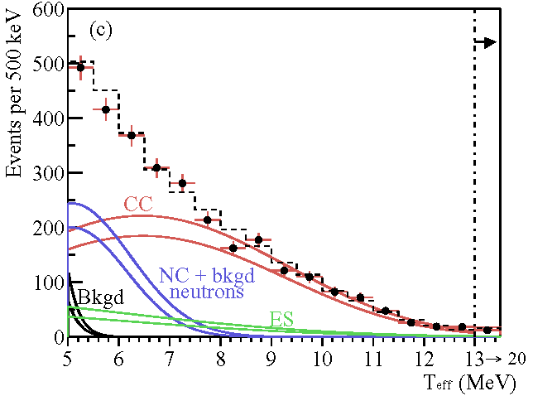
2001- Total spectrum (NC + CC + ES)
Pure D₂O
Nov 99 – May 01
n + d → t + γ
(E_{γ} = 6.25 MeV)
PRL 87, 071301 (2001)
PRL 89, 011301 (2002)
PRL 89, 011302 (2002)
PRC 75, 045502 (2007)

Slide 21
The 2001 results
The ν_{e}’s flux from ⁸B decay is measured by the CC (1) reaction: φ^{cc}(ν_{e}) = (1.75 ± 0.24) × 10⁶ cm⁻²s⁻¹
Assuming no oscillations, the total ν flux inferred from the ES (3) reaction rate is:
φ^{ES}(ν_{x}) = (2.39 ± 0.50) × 10⁶ cm⁻²s⁻¹ (SNO)
φ^{ES}_{SK}(ν_{x}) = (2.32 ± 0.08) × 10⁶ cm⁻²s⁻¹ (SK)
The difference between the ⁸B flux deduced from the ES and the CC rate at SNO and SK is:
Φ(ν_{μ}, ν_{τ})=(0.57 ± 0.17) × 10⁶ cm⁻²s⁻¹ (3.3 σ)
This difference first shows that there is a non-electron flavour active neutrino component in the solar flux !

Slide 22
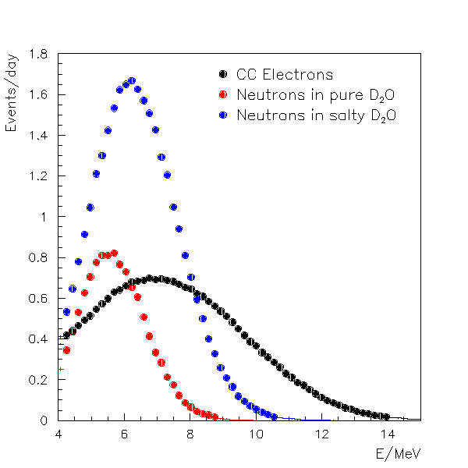
2002/03-Salt (MgCl₂ )Data.
Advantages for Neutron Detection
Higher capture cross section of n on Cl
Higher energy release
Many gammas
n
γ
³⁶Cl*
³⁵Cl
³⁶Cl
σ = 44 b
³⁵Cl+n
σ = 0.0005 b
8.6 MeV
²H+n
6.0 MeV
³H
³⁶Cl

Slide 23
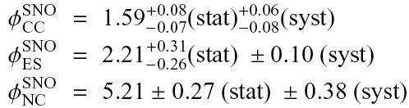
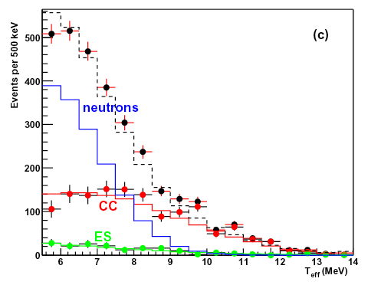
2003 SNO Energy spectra
(Salt data)
UNITS:
x 10⁶ cm⁻² s⁻¹
ATTESO: Bahcall et al. – SSM= 5.05±0.8
Electron kinetic energy

Slide 24
Latest SNO Solar ν Results
direct measure of the averaged survival probability of ⁸B solar ν
total active flux of ⁸B solar ν agrees with solar model calculations
global fit of oscillation parameters including KamLAND and all solar neutrino data, as of 2005
ν_{e} day-night asymmetry
Theory: Bahcall et al. – SSM= (5.05±0.8)x10⁶

Slide 25
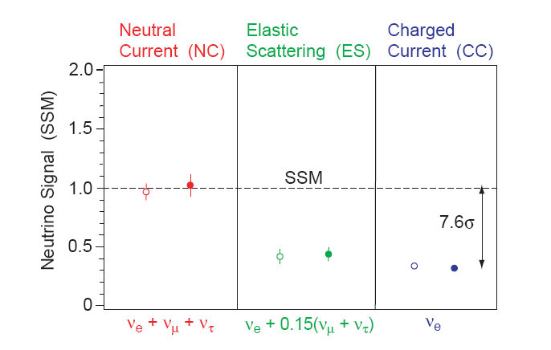
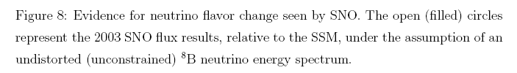

Slide 26
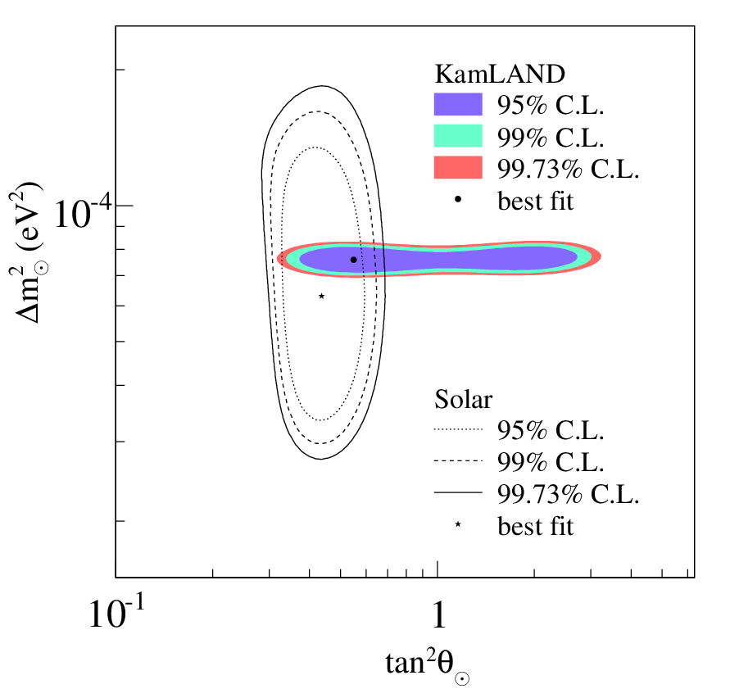
Summary
The Solar Neutrino data can be also interpreted in terms of neutrino oscillations ν_{e}→ν_{μ},ν_{τ}
SNOfinished taking data with heavy water
heavy water has been drained and returned to Atomic Energy of Canada Limited
moving on to SNO+: detector filled with liquid scintillator
includes all solar ν data up until 2005 and KamLAND reactor data

Slide 27
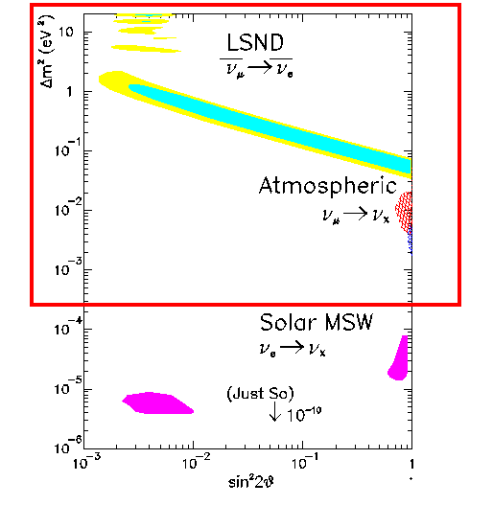
Interpretation of the Solar neutrino problem in terms of neutrino Oscillations
Allowed Regions for the Atmospheric ν data
Allowed Regions for the Solar ν data

Slide 28
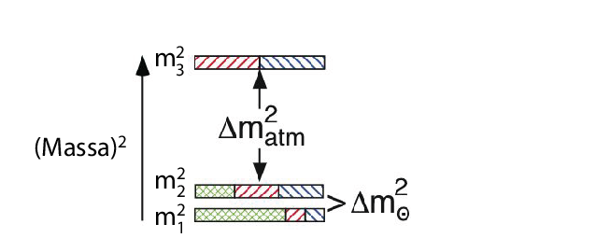

Slide 29
References
John Bahcall website
http://www.sns.ias.edu/~jnb/
Super-K website
http://www-sk.icrr.utokyo.ac.jp/doc/sk/index1.html
SNO website
http://www.sno.phy.queensu.ca/

Slide 30
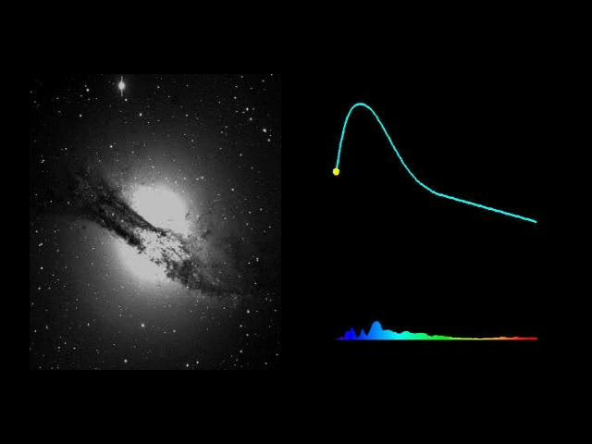
8.5 Neutrinos from a Stellar Gravitational Collapse
Una supernova nella Galassia Centaurus A. Il clip è stato preparato dal “Supernova Cosmology Project” (P. Nugent, A. Conley) con l’aiuto del Lawrence Berkeley National Laboratory's Computer Visualization Laboratory (N. Johnston: animazione) al “ National Energy Research Scientific Computing Center”
Lux = 1% neutrinos!

Slide 31
Stars with masses above eight solar masses undergo gravitational collapse.
Once the core of the star becomes constituted primarily of iron, further compression of the core does not ignite nuclear fusion and the star is unable to thermodynamically support its outer envelope.
As the surrounding matter falls inward under gravity, the temperature of the core rises and iron dissociates into α particles and nucleons.
Electron capture on protons becomes heavily favored and electron neutrinos are produced as the core gets neutronized (a process known as neutronization).
When the core reaches densities above 10¹² g/cm³, neutrinos become trapped (in the so-called neutrinosphere).
The collapse continues until 3 − 4 times nuclear density is reached, after which the inner core rebounds, sending a shock-wave across the outer core and into the mantle.
This shock-wave loses energy as it heats the matter it traverses and incites further electron-capture on the free protons left in the wake of the shock.
During the few milliseconds in which the shock-wave travels from the inner core to the neutrinosphere, electron neutrinos are released in a pulse. This neutronization burst carries away approximately 10⁵¹ ergs of energy.

Slide 32
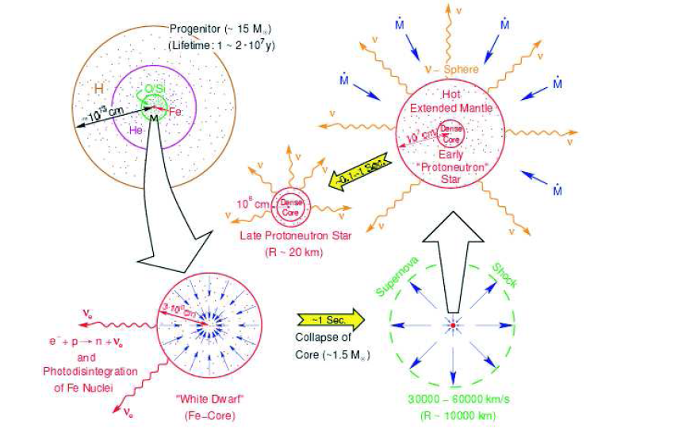
99% of the binding energy E_{b}, of the protoneutron star is released in the following ∼ 10 seconds primarily via β-decay (providing a source of electron antineutrinos), νe, ‾νe and e+e− annihilation and nucleon bremsstrahlung (sources for all flavors of neutrinos including ν_{µ}, ¯ν_{µ}, ν_{t} and ¯ν_{t} ), in addition to electron capture.
Schematic illustration of a SN explosion. The dense Fe core collapses in a fraction of a second and gets neutronized (lower-left). The inner core rebounds and gives rise to a shock-wave (lower-right). The protoneutron star cools by the emission of neutrinos.

Slide 33
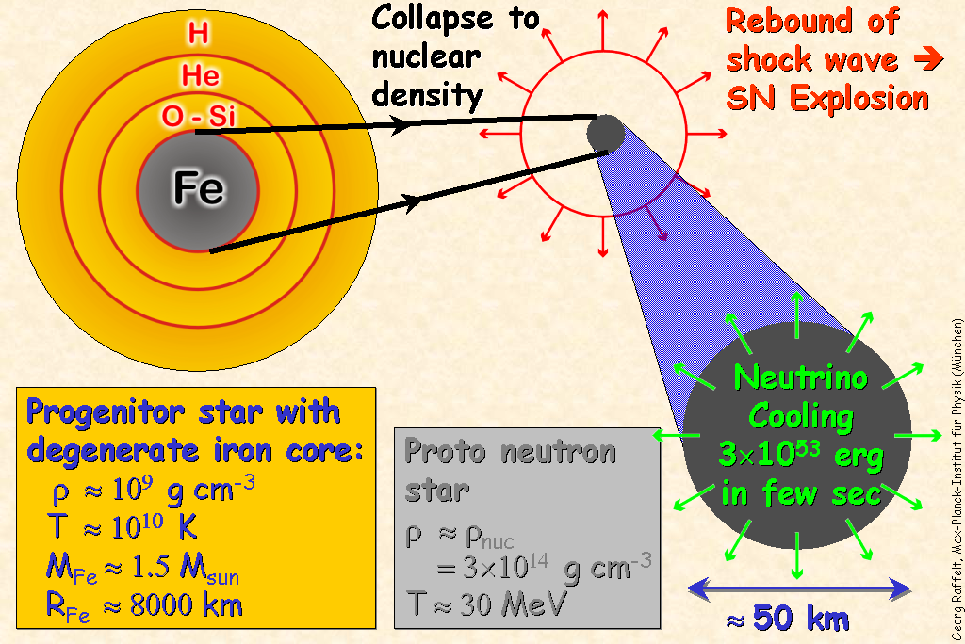

Slide 34
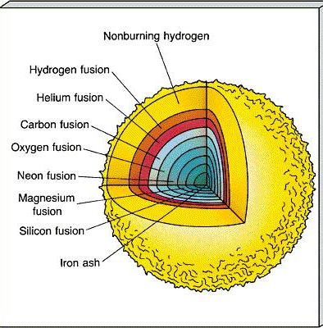
Pre supernovae
Evolutionary stages of a 25 MSUN star:
Stage Temperature (K) Duration of stage
Hydrogen burning 4 x 10⁷ 7 x 10⁶ years
Helium burning 2 x 10⁸ 5 x 10⁵years
Carbon burning 6 x 10⁸ 600 years
Neon burning 1.2 x 10⁹ 1 year
Oxygen burning 1.5 x 10⁹ 6 months
Silicon burning 2.7 x 10⁹ 1 day
Core collapse 5.4 x 10⁹ 1/4 second

Slide 35
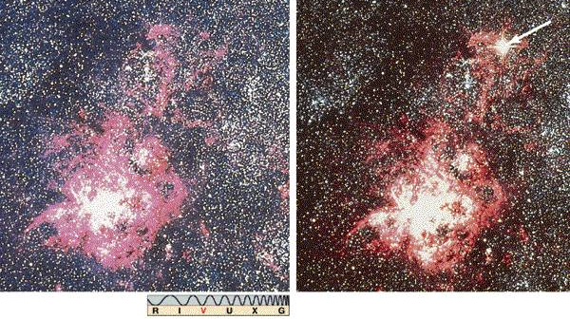
Naked eye Supernovae
SN1987A
Recorded explosions visible to naked eye:
Year (A.D.) Where observed Brightness
185 Chinese Brighter than Venus
369 Chinese Brighter than Mars or Jupiter
1006 China, Japan, Korea, Europe, Arabia Brighter than Venus
1054 China, SW India, Arabia Brighter than Venus
1572 Tycho Nearly as bright as Venus
1604 Kepler Brighter than Jupiter
1987 Ian Shelton (Chile)

Slide 36
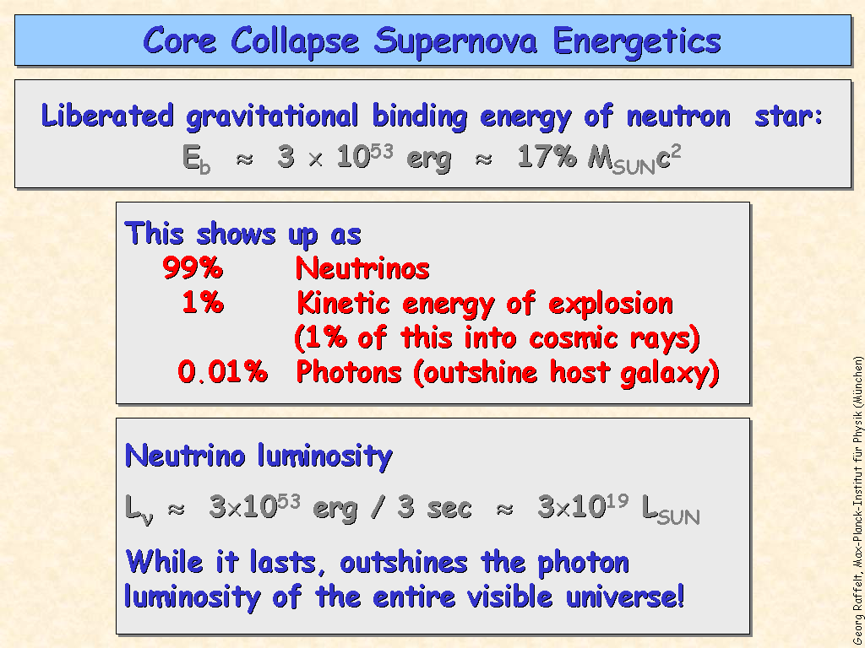
Core collapse

Slide 37
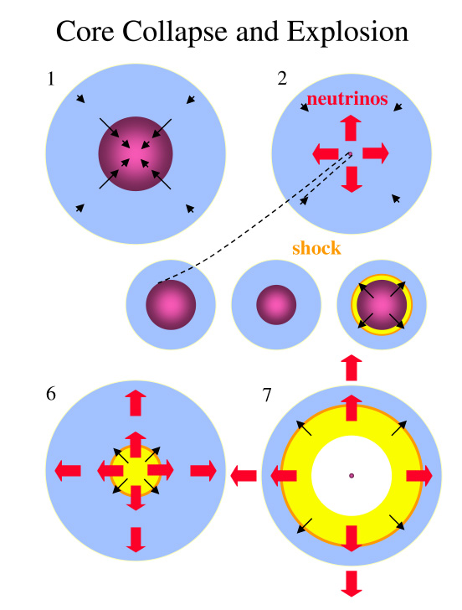
Explosion
Collapse and re-bound(1-4) creates a shock wave(5) propagating outward from center of core(6) , meeting in falling outer core material
Shock stalls due to neutrino escape & nuclear dissociation
Deleptonisation of the core creates intensive neutrino flux (99% of energy)
Neutrino interactions behind the shock reheat the shock and drive it outwards(7)
Measuring ⁵⁶Fe(ν_{e} ,e⁻ ) ⁵⁶Co provides valuable data to guide shock formation models.
Other cross sections, ²⁸Si, should also play an important role.
5

Slide 38
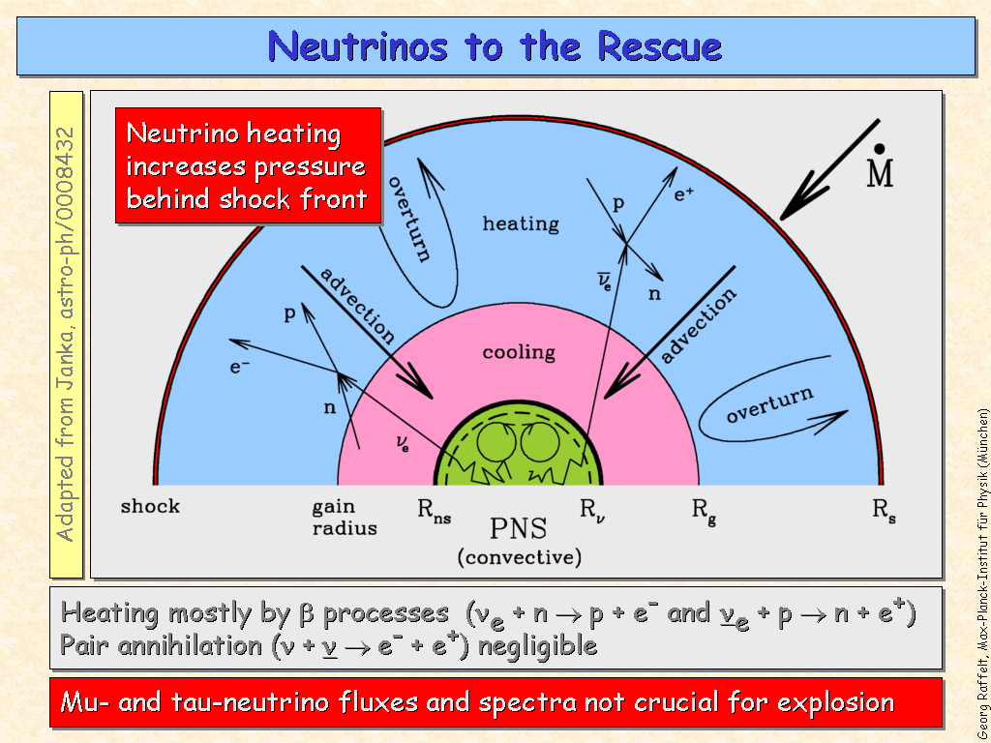
Neutrinos to the rescue

Slide 39
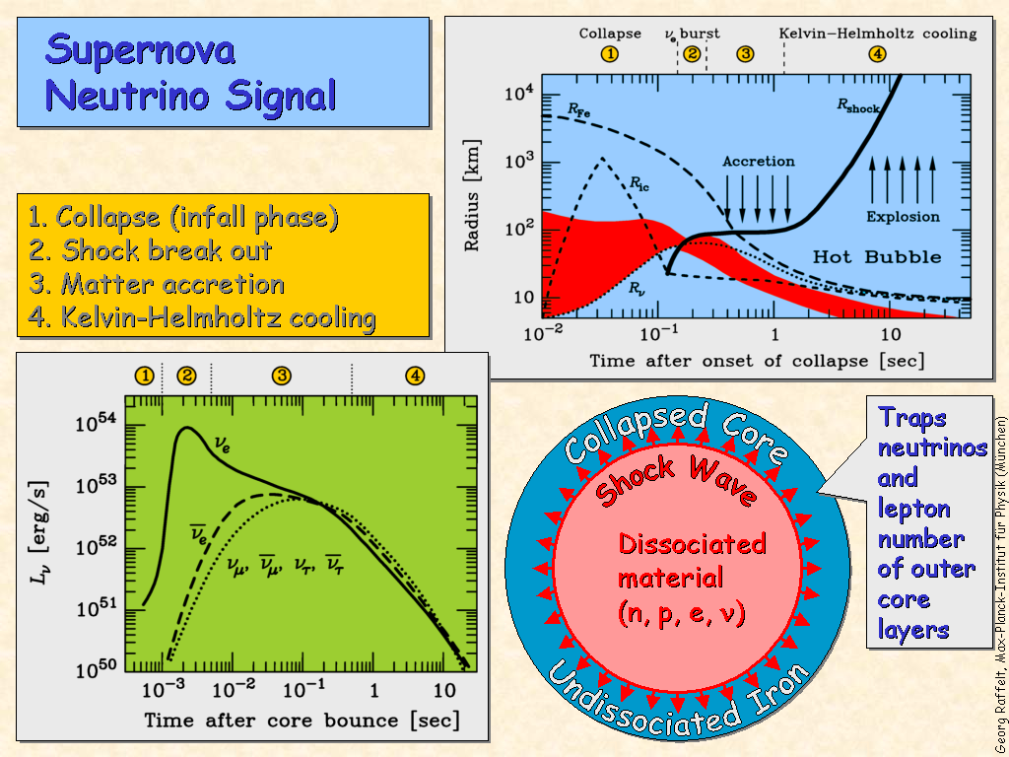
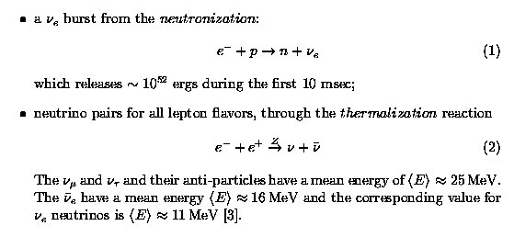
Antineutrino Luminosity

Slide 40
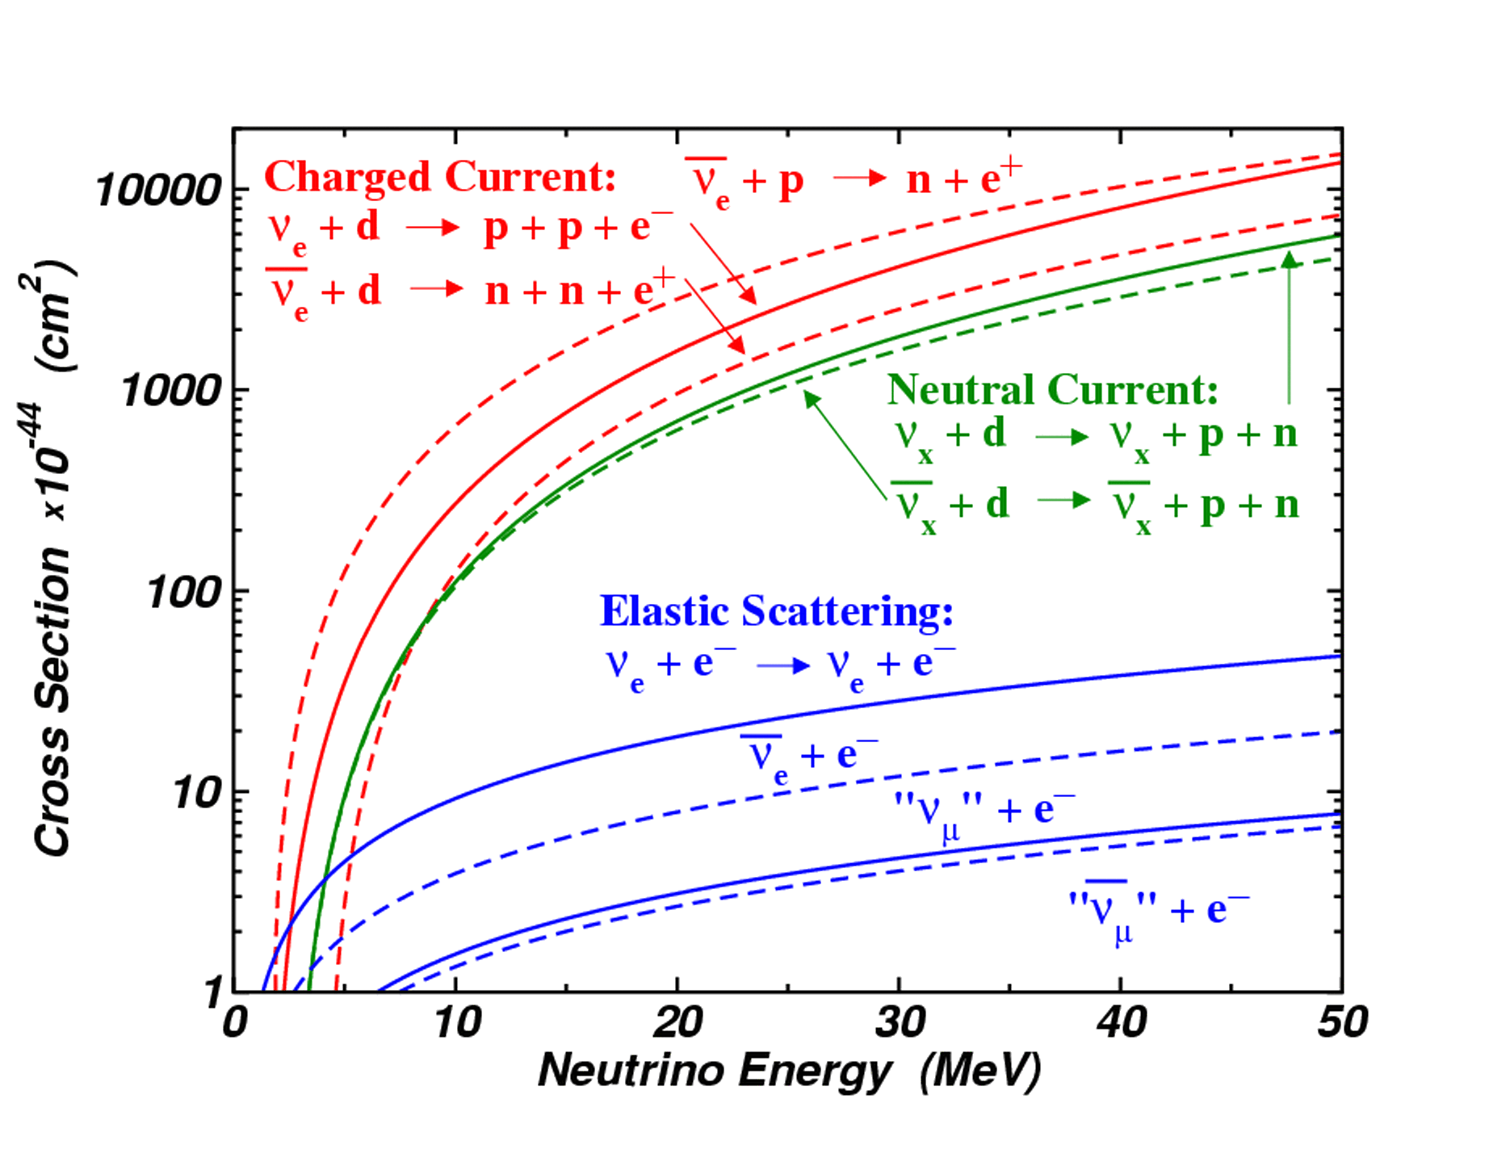
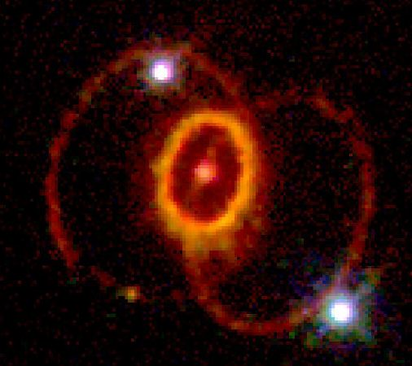
8.6 The SN1987A
_{Neutrino cross sections:}
_{Distance: 52 kpc (LMC)}

Slide 41
Introduction: Core collapse of type-II SN
Neutronization, ~10 ms
10⁵¹ erg, ν_{e} only
t=0
Thermalization: ~10 s
3×10⁵³ erg
L_{νe}(t) ≈ L_{‾νe}(t) ≈ L_{νx}(t)
Detection: mainly through
∼300 events/kt
Supernovae explode in Nature, but non in computers (J. Beacom, ν2002)

Slide 42
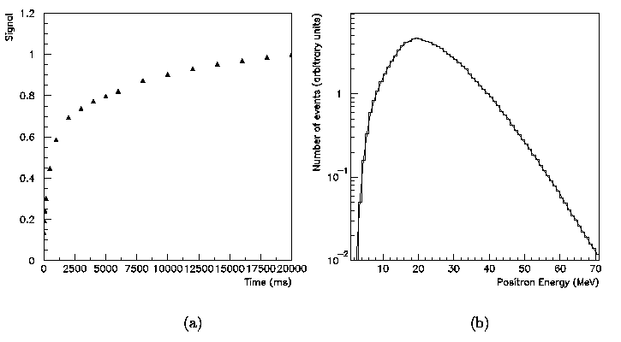
Time-energy
100%
1 s
100 ms
T (ms)
E_{e} (MeV)
(a) Time-integrated fraction of the SN positrons produced in the detector versus time. 24% of the signal it is produced in the first 100 ms after the neutronization burst. It is 60% after
1 second.
(b) Differential energy spectrum (arbitrary units) of positrons. A SN1987A-like stellar collapse was assumed.

Slide 43
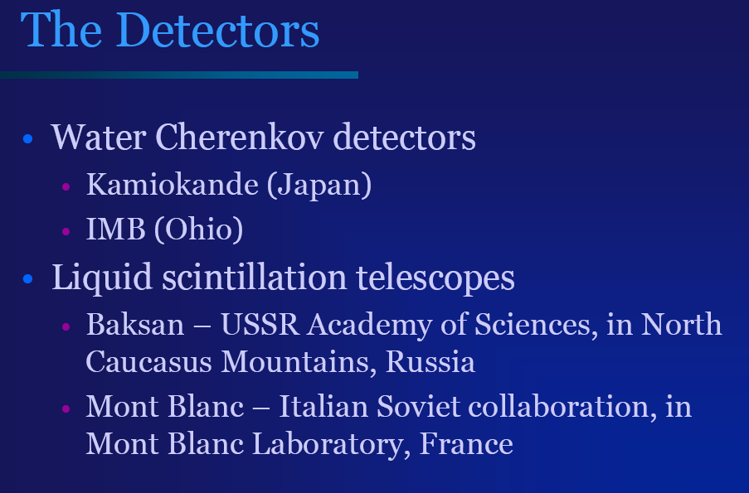
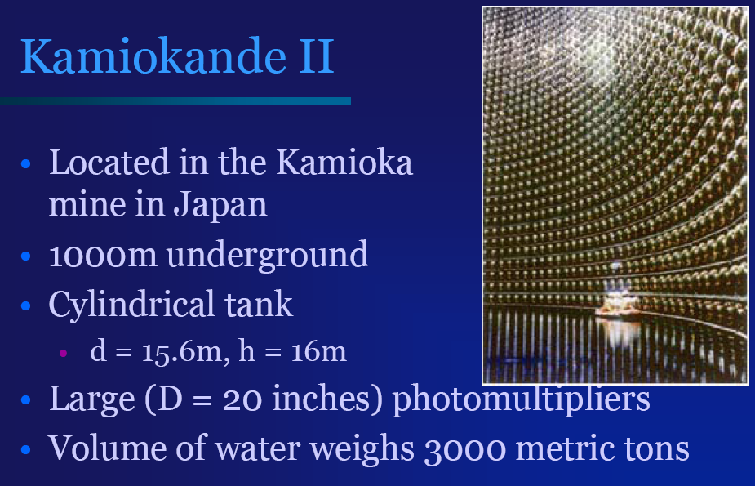
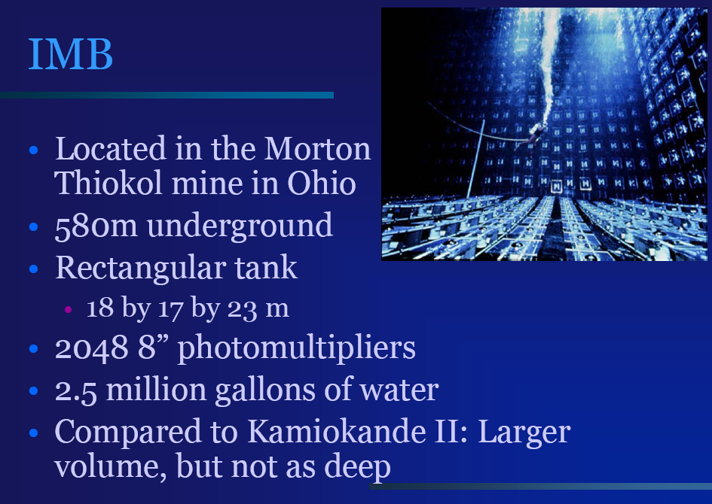
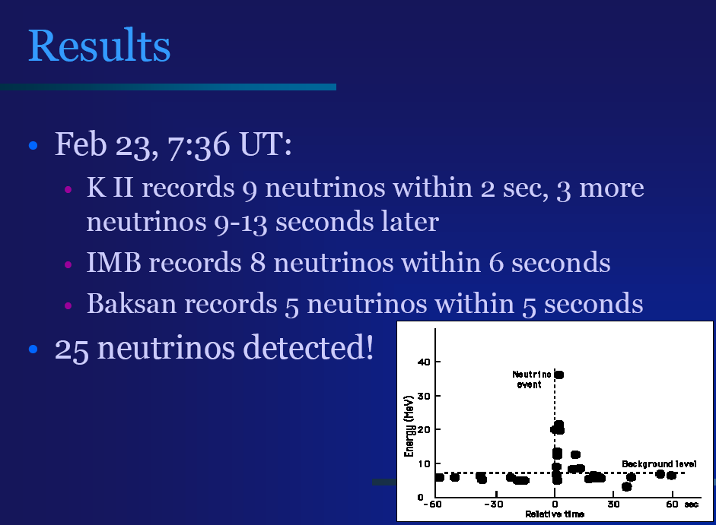
The detectors

Slide 44
The SN1987A: how many events?
1- Energy released 2.5 10⁵³ erg
2- Average ‾ν_{e} energy ≈ 16 MeV = 2.5 10⁻⁵ erg
3- N_{source}= (1/6) × 2.5 10⁵³/ (2.5 10⁻⁵)= 1.7 10⁵⁷ ‾ν_{e}
4- LMC Distance : D=52 kpc = 1.6 10²³ cm
5- Fluency at Earth: F = N_{Source}/4πD² = 0.5 10¹⁰ cm⁻²
6- Targets in 1 Kt water: N_{t} = 0.7 10³² protons
7- cross section: σ(‾ν_{e}+p) ~ 2x10⁻⁴¹ cm²
8- Ne+ = F (cm⁻²)× σ (cm²)× N_{t} (kt⁻¹)= 0.5 10¹⁰ × 2x10⁻⁴¹× 0.7 10³²
= 7 positrons/kt
9 – M(Kam II) = 2.1 kt, efficiency ε~ 80%
10 – Events in Kam II = 7 x 2.1 x ε ~ 12 events
For a SN @ Galactic Center (8.5 kpc) :
N _{events}= 7x(52/8.5)² = 260 e⁺/kt

Slide 45
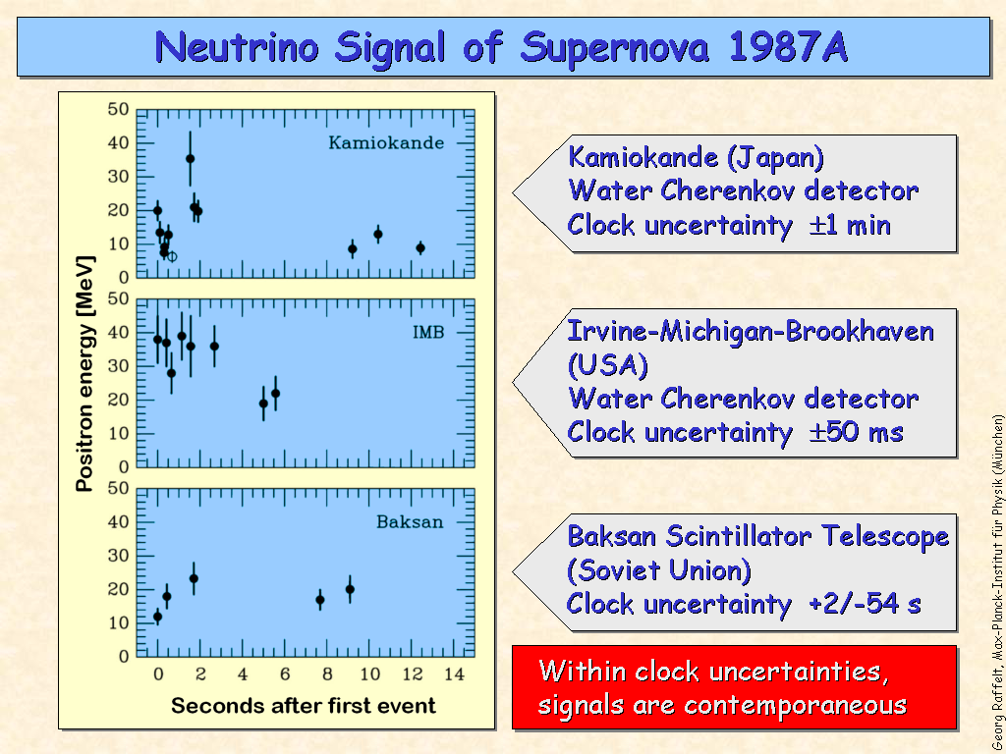
The SN1987A

Slide 46
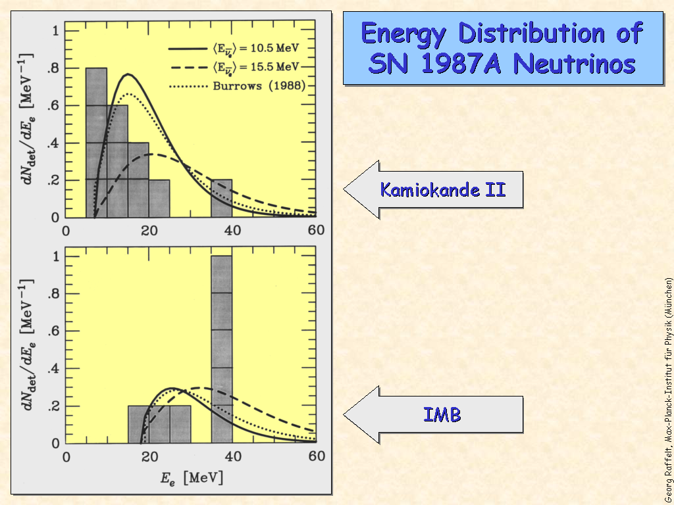
Energy from SN1987a

Slide 47
Neutrino mass from SN
The observation of supernova neutrinos should bring a better understanding of the core collapse mechanism from the feature of the time and energy spectra, and constraints the supernova models.
Moreover, an estimation of the neutrino masses could be done in the following manner. The velocity of a particle of energy E and mass m, with E >> m, is given by (with c = 1):
v = | p | = | ( E² –m²)^{½} | ≈ 1 - | m² | .
 | E |  | E |  | 2E
Thus, for a supernova at distance d, the delay of a neutrino due to its mass is, expressed in the proper units:
Δt_{[s]} ≈0.05 | m_{[eV]}² | d_{[kpc]} | .
 | E_{[MeV]}
Therefore, neutrinos of different energies released at the same instant should show a spread in their arrival time.

Slide 48
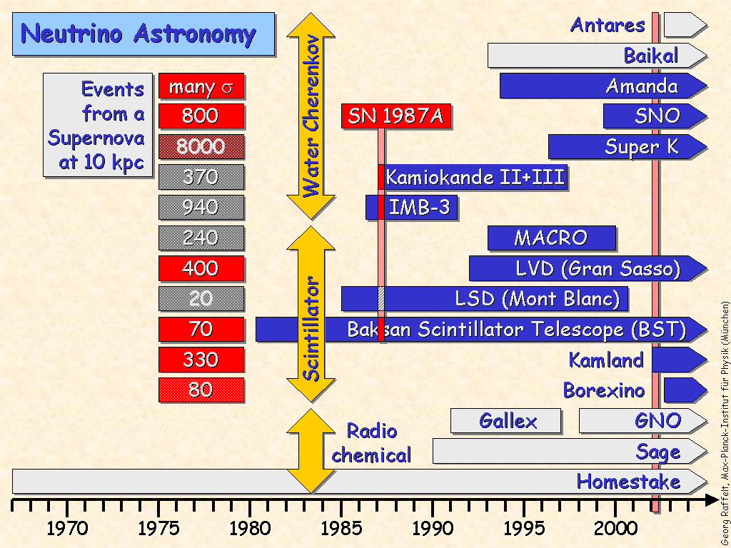
Experiments

Slide 49
References
Conclusions
The only SN seen with neutrino was SN1987a
Small experiments, small statistics
Qualitative agreement with the SN models
Wait for the next near SN with the new larger experiments (SK, SNO, Borexino, LVD…)
→ neutrino properties (mass, livetime, magnetic moment)from astrophysics
http://www.supernovae.net/

