Slide 1
9. Neutrino Astronomy
Corso “Astrofisica delle particelle”
Prof. Maurizio Spurio
Università di Bologna. A.a. 2011/12

Slide 2
Outlook
Why Neutrino Astronomy?
Astrophysical Sources of ν_{μ}
A Numerical example. A Galactic source of neutrinos: neutron star with accretion disk
Event rate in a underground detector
Upper Bounds on Neutrino Diffuse Fluxes
Neutrino telescopes
ICECUBE, ANTARES, NEMO
The KM3 project in the Mediterranean sea

Slide 3
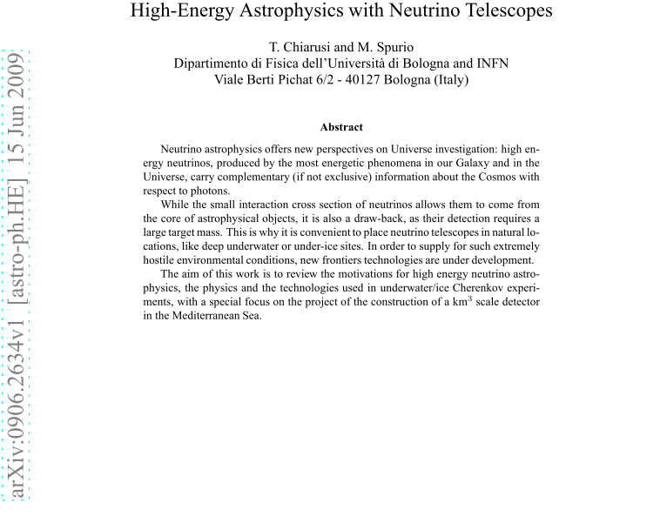
See: hep-ph 0906.2634

Slide 4
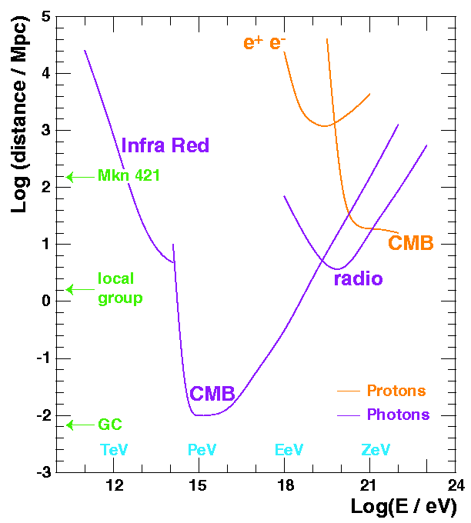
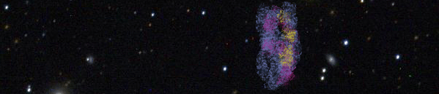
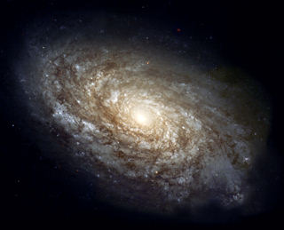
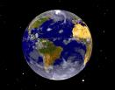
9.1 Why Neutrino Astronomy?
Photon and proton mean free range path
Neutrino Astronomy is a quite recent and very promising experimental field.
Advantages:
  Photons: interact with CMB and matter (r~10 kpc @100 TeV)
  Protons: interact with CMB (r~10 Mpc @10¹¹ GeV) and undergo magnetic fields (Δθ>1º, E<5·10¹⁰ GeV)
  Neutrons: are not stable (r∼10 kpc @10⁹ GeV)
Drawback: large detectors (~GTon) are needed.
γ
n
ν
p
Notes:
OK, so Neutrino Astronomy is a very recent and very promising experimental field in Astrophysics, in particular in the high energy region.
The main advantages of neutrinos with respect to other astrophysical probes are summarized here:
The range of high energy photons is limited by their interaction with the cosmic microwave background, as shown here. We can see that, for energies around 100 TeV, the range is not more that the distance to the Galactic Center.
The range of protons is also limited by the interaction with the cosmic microwave background. Moreover, since they are charged particles, the Galactic and extra-Galactic fields spoils the angular information.
And neutrons, which are neutral, are not either useful, since they are not stable. Even at very high energies, their range is very limited.
So we must look for a particle which is stable, neutral and weakly interacting, and this particle is the neutrino. However, the drawback of neutrinos is that since they only interact weakly, very large detectors are needed.

Slide 5
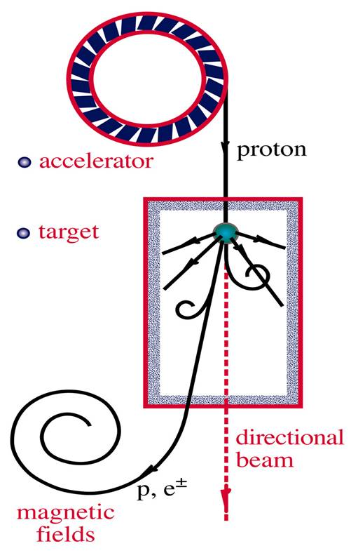
Production Mechanisms
Neutrinos are expected to be produced in the interaction of high energy nucleons with matter or radiation:
Cosmic rays
In these scenarios, high energy photons would also be produced:
Gamma ray astronomy
Notes:
How can neutrinos be produced in astrophysical sources? They are expected to be produced in the interaction of high energy nucleons with ambient photons and surrounding matter. In this interaction, pions and other mesons are created. The decay of these pions will give rise to a muons and neutrinos. Moreover, the decay of the muons will produce more neutrinos.
On the other hand, these interactions can also produce neutral pions, which would decay to high energy photons.
This shows the direct link of high energy neutrinos with cosmic rays and neutrino astronomy, so we will review some important issues about them.

Slide 6
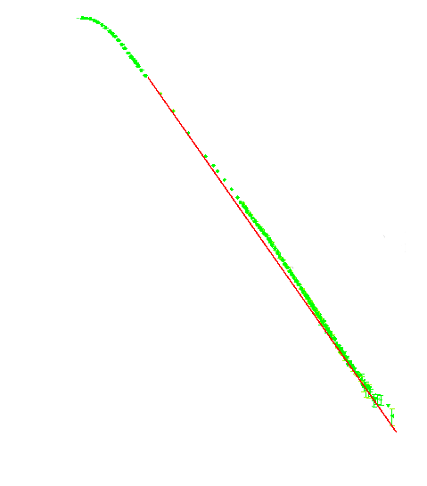
Cosmic Rays ←→ Neutrinos
Cosmic rays follow a broken power-law:
Beyond 6×10¹⁹ eV, the flux should vanish due to the interaction of protons with the CMB (GZK limit)
High energy neutrinos could give information about the origin of cosmic rays.
Cosmic Ray Flux
Flux (m² sr s GeV)⁻¹
(1 particle per m² - second)
the knee
the ankle
SNRs
Knee
(1 particle per m²- year)
Pulsars?
AGNs?
Ankle
(1 particle per km²-year)
Energy (eV)
Notes:
OK, so first let’s have a look at cosmic rays. Here you can see the energy spectrum of cosmic rays, which extends in a very wide range, following a broken power law. The main features of this spectrum are the knee, at 5 PeV, and the ankle, at 3 EeV. Cosmic rays observed before the knee are believed to be produced in supernova remnants by the Fermi acceleration mechanism. At higher energies, the situation is much less clear. Pulsars are one of the candidates, but not the only ones. Beyond the ankle, there are increasing hints to an extra-Galactic origin, so objects like AGNs or GRBs are possible explanations.
Above 60 EeV, the flux should vanish due to the interaction of protons with the CMB, which is known as the GZK effect. However, there some experiments like AGASA have observed a significant flux above this energy. This is still a controversial issue which needs further experimental efforts.
We have seen, furthermore, that many intriguing questions about the origin of cosmic rays have still to be solved, and neutrino astronomy can help to answer them.

Slide 7
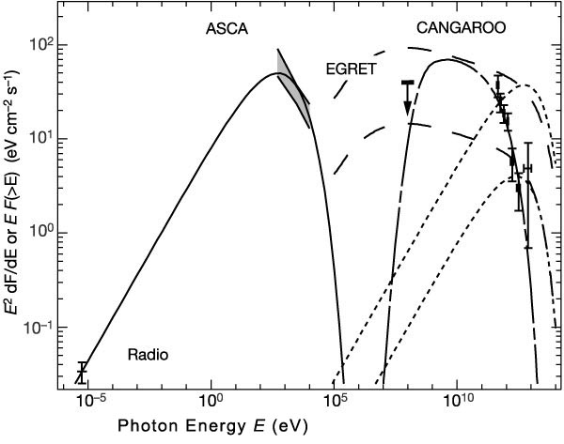
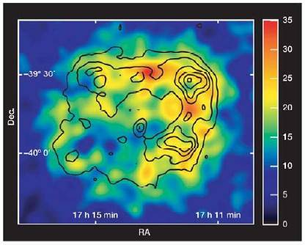
High Energy Photons (see cap. 6)
The observation of TeV photons can be explained by
-leptonic processes (inverse Compton, bremsstrahlung) or
-the decay of neutral pions produced in hadronic interactions (→neutrino).
TeV gamma-ray image of RX J1713.7-3946 (H.E.S.S.). The superimposed contours show the X-ray surface brightness as seen by ASCA in the 1-3 keV range.
SNR RX 1713.7-3946 emission better explained by π⁰ decay (still controversial)
synchrotron
inverse Compton
bremsstrahlung
π⁰ decay
Notes:
As we have mentioned, the high energy photon astronomy is also directly linked with neutrino astronomy. TeV photon emission have been observed by several experiments like Whipple, HEGRA or CANGAROO. The explanations of the origin of such photons involves two kinds of models: leptonic processes, like inverse Compton scattering or bremsstrahlung) and the decay of neutral pions produced in the interaction of accelerated protons with matter or ambient photons, as we have seen before. In the latter case, neutrinos would be also produced (by the decay of charged pions), so neutrino astronomy can play an important role to determine which are the dominant process. As an example, we cad mention the observations of CANGAROO, which seem to agree better with a hadronic origin according to some authors, although this is still controversial.

Slide 8
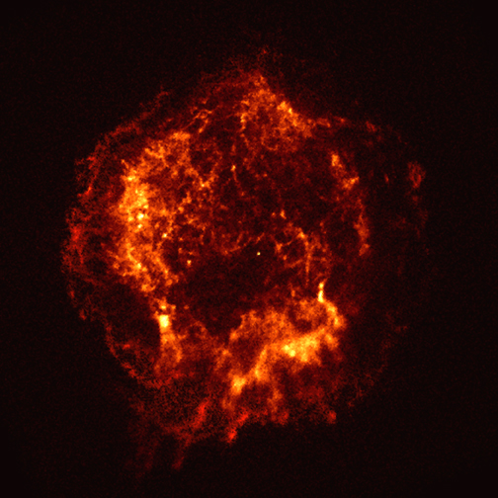
γ and ν in cosmic accelerators
CR
ν
π±
p
γ
π⁰
e±
γ
Inverse Compton
(+Bremsstr.)
protons/nuclei
electrons/positrons
radiation fields and matter

Slide 9
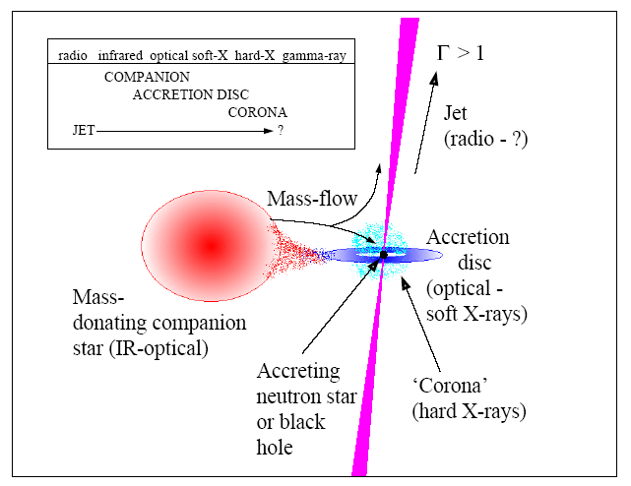
9.2 Astrophysical Sources
Galactic sources: these are near objects (few kpc) so the luminosity requirements are much lower.
  Micro-quasars
Micro-quasars: a compact object (BH or NS) towards which a companion star is accreting matter.
Neutrino beams could be produced in the Micro-Qquasar jets.
Several neutrinos per year could be detected by 1 km3 detector.
Notes:
We are going now to review some of the most relevant candidates to emit detectable neutrino rates in ANTARES.
Among the Galactic sources, one of the most promising sources are MQs. The name of these objects is due to the fact that they seem a reduced version of a Quasar. They consist It consists of a compact object towards which a companion star is accreting matter. Neutrino beams could be produced in the MQ jets, with rates which could be of the order of 10 in ANTARES for best candidates.
Another interesting kind of sources is the SNRs. The most interesting scenarios for neutrino astronomy are shown here: plerions (which are center-filled SNRs, like the Crab, shown here), shell-type remnants and SNRs containing an energetic pulsar. As shown here, the predicted rates range from 1 to 100 events per year in a km² detector.
Another good Galactic candidate is magnetars, which are isolated neutrons stars with very large magnetic fields. Seismic activity in the surface could induce particle acceleration in the magnetosphere, giving several neutrino events per year and km₂. These predictions depends strongly on the beaming angle.
Concerning the extra-Galactic sources, we are interested in the most powerful objects in the Universe. On the one hand, the AGNs. This classification includes several kinds of objects: Seyferts I and II, quasars, radio galaxies and blazars. The standard model of AGNs assumes that are the same kind of object viewed from different angles. According to this model, AGNs consist in a super-massive (10⁶-10⁸ M_{o}) black hole towards which large amounts of matter are accreted. If there is hadronic acceleration in the jets, detectable neutrino rates could be expected.
Finally, Gamma Ray Busters are also interesting for neutrino astronomy. According to the fireball model, ejecta of matter moving at relativistic velocities collides with the surrounding material. These collisions produce high energy gamma ray and probably also high energy neutrinos. In this case we can use the time information of the event, which allows us to reduce reject almost all the background.

Slide 10
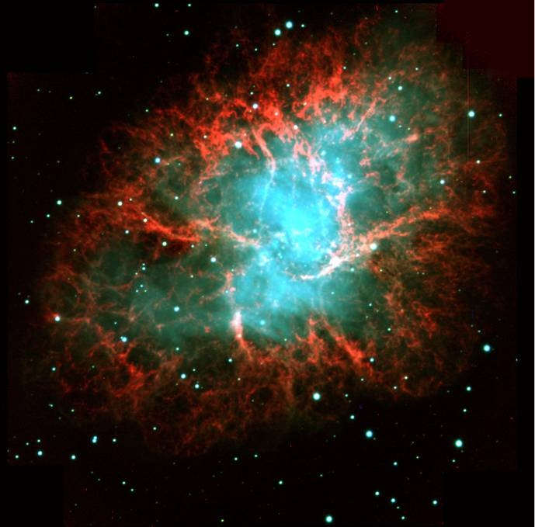
Astrophysical Sources
Galactic sources: these are near objects (few kpc) so the luminosity requirements are much lower.
  Micro-quasars
  Supernova remnants
Several scenarios (optimistic?):
Plerions (center-filled SNRs): 1-14 ev/km³· y.
Shell-type SNRs: 40-140 ev/km³· y.
SNRs with energetic pulsars: ~100 ev/km³· y.
Notes:
We are going now to review some of the most relevant candidates to emit detectable neutrino rates in ANTARES.
Among the Galactic sources, one of the most promising sources are MQs. The name of these objects is due to the fact that they seem a reduced version of a Quasar. They consist It consists of a compact object towards which a companion star is accreting matter. Neutrino beams could be produced in the MQ jets, with rates which could be of the order of 10 in ANTARES for best candidates.
Another interesting kind of sources is the SNRs. The most interesting scenarios for neutrino astronomy are shown here: plerions (which are center-filled SNRs, like the Crab, shown here), shell-type remnants and SNRs containing an energetic pulsar. As shown here, the predicted rates range from 1 to 100 events per year in a km² detector.
Another good Galactic candidate is magnetars, which are isolated neutrons stars with very large magnetic fields. Seismic activity in the surface could induce particle acceleration in the magnetosphere, giving several neutrino events per year and km₂. These predictions depends strongly on the beaming angle.
Concerning the extra-Galactic sources, we are interested in the most powerful objects in the Universe. On the one hand, the AGNs. This classification includes several kinds of objects: Seyferts I and II, quasars, radio galaxies and blazars. The standard model of AGNs assumes that are the same kind of object viewed from different angles. According to this model, AGNs consist in a super-massive (10⁶-10⁸ M_{o}) black hole towards which large amounts of matter are accreted. If there is hadronic acceleration in the jets, detectable neutrino rates could be expected.
Finally, Gamma Ray Busters are also interesting for neutrino astronomy. According to the fireball model, ejecta of matter moving at relativistic velocities collides with the surrounding material. These collisions produce high energy gamma ray and probably also high energy neutrinos. In this case we can use the time information of the event, which allows us to reduce reject almost all the background.

Slide 11
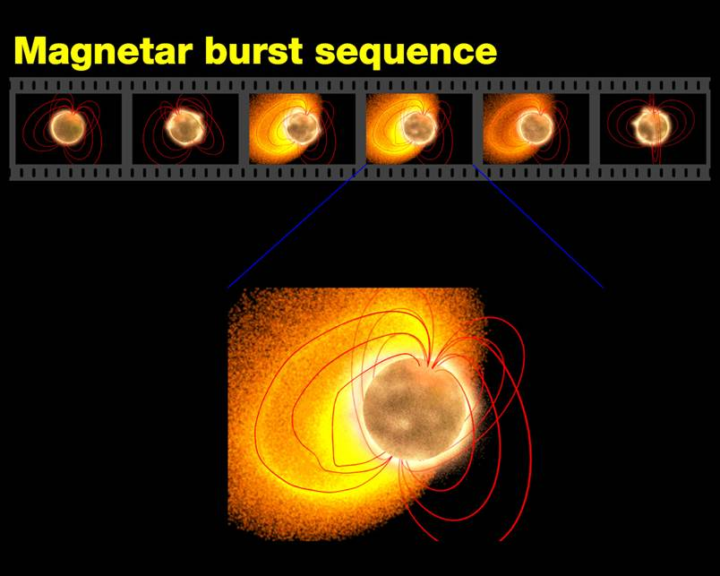
Astrophysical Sources
Galactic sources: these are near objects (few kpc) so the luminosity requirements are much lower.
  Micro-quasars
  Supernova remnants
  Magnetars
  …
Isolated neutron stars with surface dipole magnetic fields ~10¹⁵ G, much larger than ordinary pulsars.
Seismic activity in the surface could induce particle acceleration in the magnetosphere.
Event rate: ~1 (0.1/ΔΩ) ev/km³· y.
Notes:
We are going now to review some of the most relevant candidates to emit detectable neutrino rates in ANTARES.
Among the Galactic sources, one of the most promising sources are MQs. The name of these objects is due to the fact that they seem a reduced version of a Quasar. They consist It consists of a compact object towards which a companion star is accreting matter. Neutrino beams could be produced in the MQ jets, with rates which could be of the order of 10 in ANTARES for best candidates.
Another interesting kind of sources is the SNRs. The most interesting scenarios for neutrino astronomy are shown here: plerions (which are center-filled SNRs, like the Crab, shown here), shell-type remnants and SNRs containing an energetic pulsar. As shown here, the predicted rates range from 1 to 100 events per year in a km² detector.
Another good Galactic candidate is magnetars, which are isolated neutrons stars with very large magnetic fields. Seismic activity in the surface could induce particle acceleration in the magnetosphere, giving several neutrino events per year and km₂. These predictions depends strongly on the beaming angle.
Concerning the extra-Galactic sources, we are interested in the most powerful objects in the Universe. On the one hand, the AGNs. This classification includes several kinds of objects: Seyferts I and II, quasars, radio galaxies and blazars. The standard model of AGNs assumes that are the same kind of object viewed from different angles. According to this model, AGNs consist in a super-massive (10⁶-10⁸ M_{o}) black hole towards which large amounts of matter are accreted. If there is hadronic acceleration in the jets, detectable neutrino rates could be expected.
Finally, Gamma Ray Busters are also interesting for neutrino astronomy. According to the fireball model, ejecta of matter moving at relativistic velocities collides with the surrounding material. These collisions produce high energy gamma ray and probably also high energy neutrinos. In this case we can use the time information of the event, which allows us to reduce reject almost all the background.

Slide 12
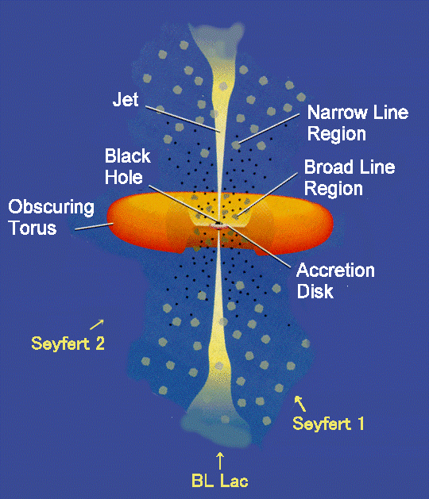
Astrophysical Sources
Galactic sources: these are near objects (few kpc) so the luminosity requirements are much lower.
  Micro-quasars
  Supernova remnants
  Magnetars
  …
Extra-galactic sources: most powerful sources in the Universe
  AGNs
Active Galactic Nuclei includes Seyferts, quasars, radio galaxies and blazars.
Standard model: a super-massive (10⁶-10⁸ M_{o}) black hole towards which large amounts of matter are accreted.
Detectable neutrino rates (~1-10 ev/year/km³) could be produced.
Notes:
We are going now to review some of the most relevant candidates to emit detectable neutrino rates in ANTARES.
Among the Galactic sources, one of the most promising sources are MQs. The name of these objects is due to the fact that they seem a reduced version of a Quasar. They consist It consists of a compact object towards which a companion star is accreting matter. Neutrino beams could be produced in the MQ jets, with rates which could be of the order of 10 in ANTARES for best candidates.
Another interesting kind of sources is the SNRs. The most interesting scenarios for neutrino astronomy are shown here: plerions (which are center-filled SNRs, like the Crab, shown here), shell-type remnants and SNRs containing an energetic pulsar. As shown here, the predicted rates range from 1 to 100 events per year in a km² detector.
Another good Galactic candidate is magnetars, which are isolated neutrons stars with very large magnetic fields. Seismic activity in the surface could induce particle acceleration in the magnetosphere, giving several neutrino events per year and km₂. These predictions depends strongly on the beaming angle.
Concerning the extra-Galactic sources, we are interested in the most powerful objects in the Universe. On the one hand, the AGNs. This classification includes several kinds of objects: Seyferts I and II, quasars, radio galaxies and blazars. The standard model of AGNs assumes that are the same kind of object viewed from different angles. According to this model, AGNs consist in a super-massive (10⁶-10⁸ M_{o}) black hole towards which large amounts of matter are accreted. If there is hadronic acceleration in the jets, detectable neutrino rates could be expected.
Finally, Gamma Ray Busters are also interesting for neutrino astronomy. According to the fireball model, ejecta of matter moving at relativistic velocities collides with the surrounding material. These collisions produce high energy gamma ray and probably also high energy neutrinos. In this case we can use the time information of the event, which allows us to reduce reject almost all the background.

Slide 13
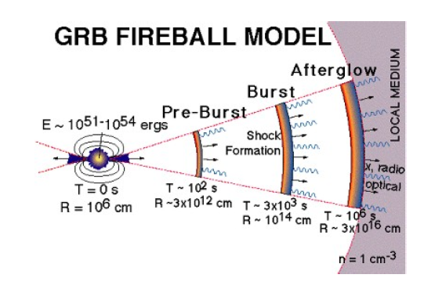
Astrophysical Sources
Galactic sources: these are near objects (few kpc) so the luminosity requirements are much lower.
  Micro-quasars
  Supernova remnants
  Magnetars
  …
Extra-galactic sources: most powerful sources in the Universe
  AGNs
  GRBs
GRBs are brief explosions of γ rays
(often + X-ray, optical and radio).
In the fireball model, matter moving at relativistic velocities collides with the surrounding material. The progenitor could be a collapsing super-massive star.
Time correlation enhances the neutrino detection efficiency.
Notes:
We are going now to review some of the most relevant candidates to emit detectable neutrino rates in ANTARES.
Among the Galactic sources, one of the most promising sources are MQs. The name of these objects is due to the fact that they seem a reduced version of a Quasar. They consist It consists of a compact object towards which a companion star is accreting matter. Neutrino beams could be produced in the MQ jets, with rates which could be of the order of 10 in ANTARES for best candidates.
Another interesting kind of sources is the SNRs. The most interesting scenarios for neutrino astronomy are shown here: plerions (which are center-filled SNRs, like the Crab, shown here), shell-type remnants and SNRs containing an energetic pulsar. As shown here, the predicted rates range from 1 to 100 events per year in a km² detector.
Another good Galactic candidate is magnetars, which are isolated neutrons stars with very large magnetic fields. Seismic activity in the surface could induce particle acceleration in the magnetosphere, giving several neutrino events per year and km₂. These predictions depends strongly on the beaming angle.
Concerning the extra-Galactic sources, we are interested in the most powerful objects in the Universe. On the one hand, the AGNs. This classification includes several kinds of objects: Seyferts I and II, quasars, radio galaxies and blazars. The standard model of AGNs assumes that are the same kind of object viewed from different angles. According to this model, AGNs consist in a super-massive (10⁶-10⁸ M_{o}) black hole towards which large amounts of matter are accreted. If there is hadronic acceleration in the jets, detectable neutrino rates could be expected.
Finally, Gamma Ray Busters are also interesting for neutrino astronomy. According to the fireball model, ejecta of matter moving at relativistic velocities collides with the surrounding material. These collisions produce high energy gamma ray and probably also high energy neutrinos. In this case we can use the time information of the event, which allows us to reduce reject almost all the background.

Slide 14
9.3 Recipes for a Neutrino Telescope
M. Markov:
“We propose to install detectors deep in a lake or in the sea and to determine the direction of the charged particles with the help of Cherenkov radiation”
1960, Rochester Conference

Slide 15
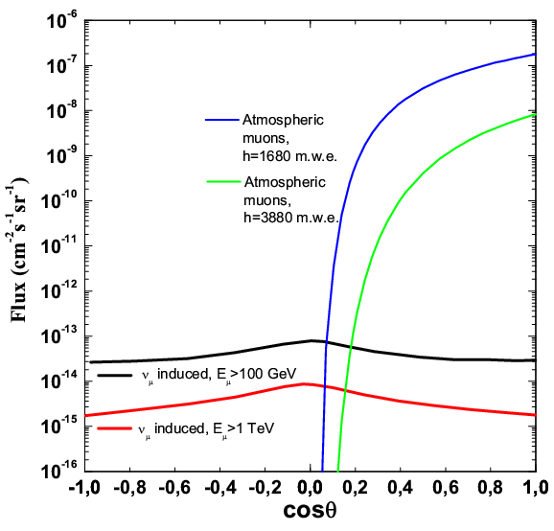
Deep in a transparent medium
Water or Ice:
  large (and inexpensive ) target for ν interaction
  transparent radiators for Cherenkov light;
  large deep: protection against the cosmic-ray muon background
μ
ν

Slide 16
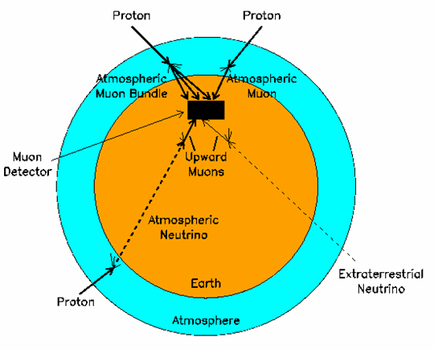
νT: a detector looking to the bottom
Atmospheric muons dominate by many order of magnitude the neutrino-induced muons.
Only upward-going particles are candidate for extraterrestrial ν .
Atmospheric neutrinos represent the irreducible background for NT
Upward-going muons (or horizontal muons) ARE neutrino-induced!

Slide 17
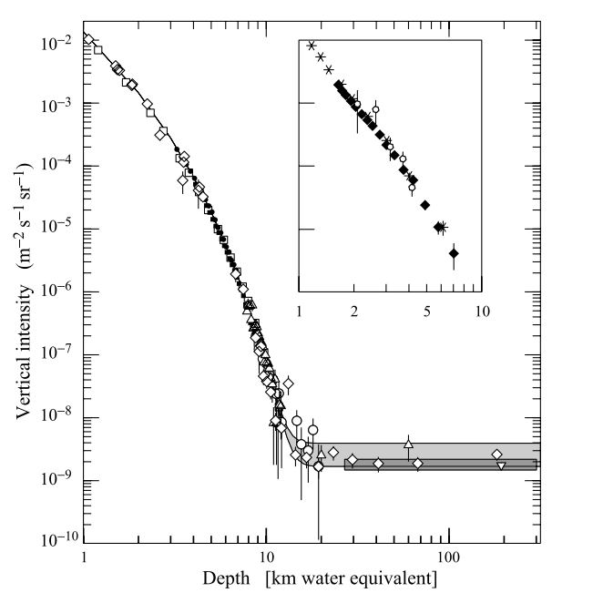
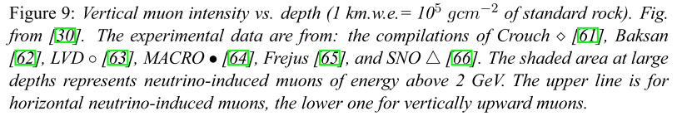
Atmospheric muon flux
Muons cannot cross more than ≈ 15 km.w.e.

Slide 18
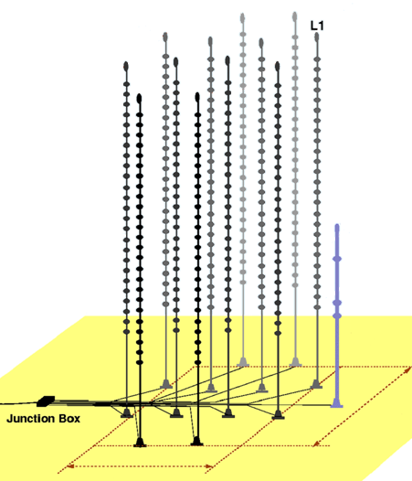
Neutrino telescope=
Istrumented detector D<R_{μ}
μ
A- Source neutrino energy spectrum
Event number / (area × time)
B- ν-induced muon detection probability
C- Earth absorption probability for ν

Slide 19
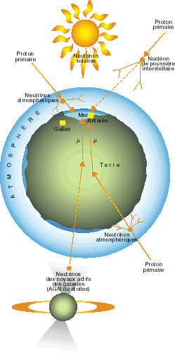
A) Example of a Galactic source of neutrinos.
TeV γ-rays and neutrinos can be produced from hadronic processes:
p + γ → Δ⁺→ πº+ p
p + γ → Δ⁺→ π⁺+ n
Neutral mesons decay in photons:
πº→ γγ
charged mesons decay in neutrinos:
π⁺→ ν_{µ} + µ+
µ⁺ → ν_{µ} + ν_{e} + e⁺
π⁻ → ν_{µ} + µ⁻
µ⁻ → ν_{µ} + ν_{e} + e⁻
#ν=#γ

Slide 20
A source candidate: RX J1713.7-3946
RX J1713.7-3946 seen by HESS (gamma rays)
10
-10
~E⁻²
]
10
-11
-1
TeV
10
-12
-1
s
-2
10
-13
Flux [cm
10
-14
10
-15
10
-16
0,1
1
10
100
Energy [TeV]

Slide 21
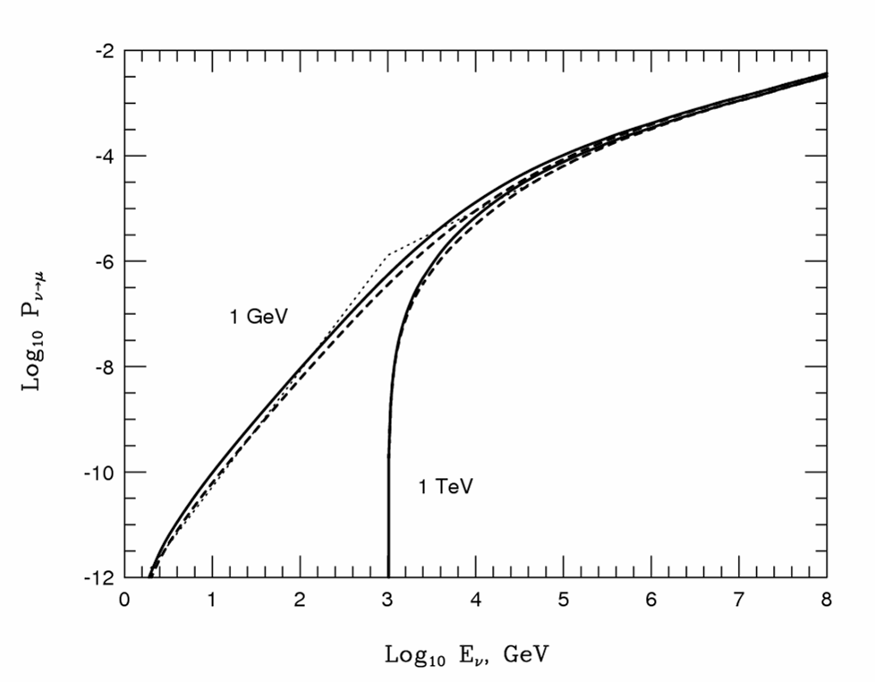
Β) μ production probability
Neutrino cross section
~E_{μ}
P_{ν◊μ}=10⁻⁶E_{ν}^{0.8}
(E_{ν} in TeV)
Muon range
~E_{μ,}
E_{μ} <0.5 TeV

Slide 22
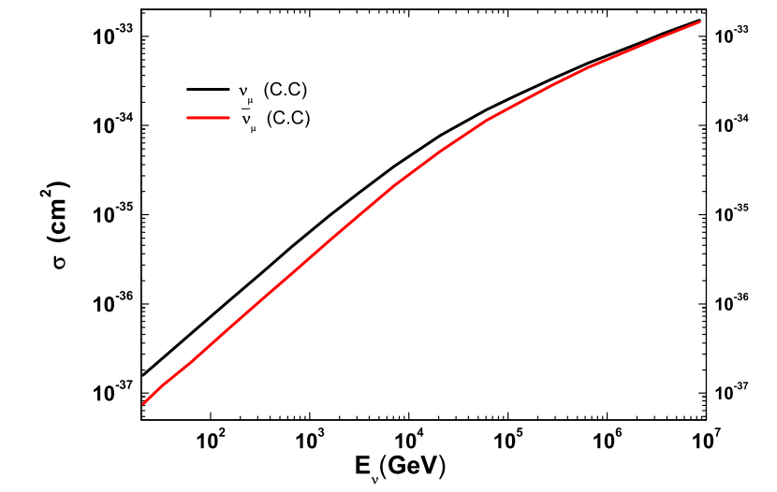
Neutrino cross section
Problem: estimate the energy of the neutrino for which the Earth is not anymore transparent

Slide 23
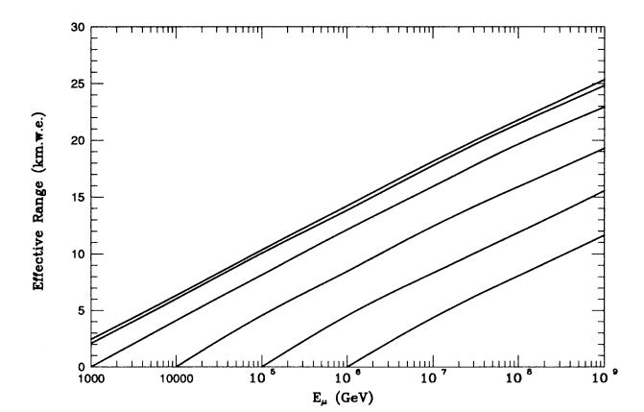

Muon Range

Slide 24
→ Detector size

Slide 25
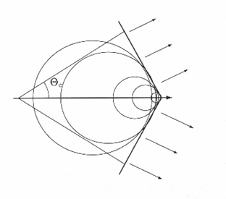
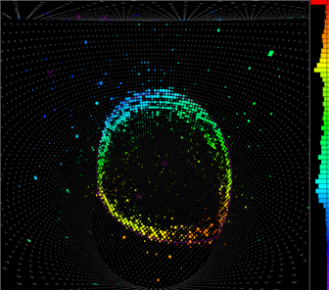
Cherenkov light emission
Cherenkov light emitted by reletivistic particles in a trasparent medium, with : βn(λ) > 1
Dominant photon emission in the blue-UV band (see cap. 7).
In the range in which water/ice are most transparent:
Superkamiokande
muon event

Slide 26
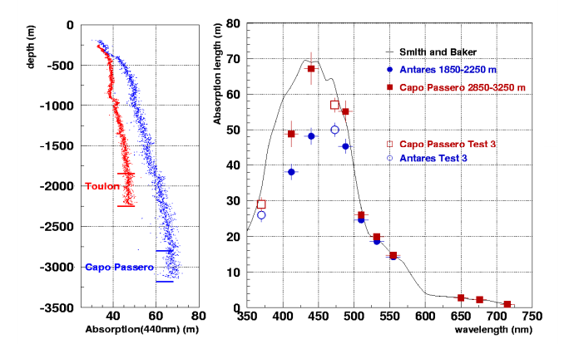
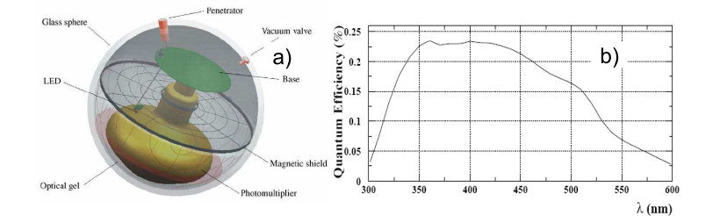
Water properties/optical module
Water absorption length measured in the Toulon (blue) and Capo Passero (red). Left: La(λ) with λ = 440 nm as function of the depth. Right: various measurement of the absorption length in the two sites as function of the wavelength, compared to the
behaviour of pure seawater (solid line).

Slide 27
How many light sensors → € ?
Problem: Let assume a muon track of L_{μ}=1 km. How many PMTs N_{PMT} are needed in 1 km³ detector volume in order to detect ~100 photoelectrons N_{pe} ?
10” PMT =0.05 m²
N_{γ}= L_{μ} ×300 γ/cm= 3x10⁷ γ
N_{pe}= N_{γ} × ε_{QE} × N_{PMT}× (V_{PMT}/1 km³)
=100
N_{PMT}=5000
L_{ass}~60 m
V_{PMT}= 3 m³

Slide 28
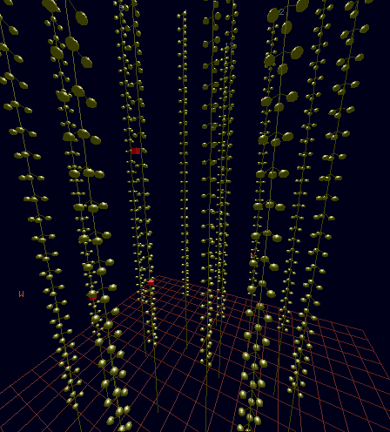
Track reconstruction
Cherenkov photons emitted by a μ crossing the detector are correlated in space and time
μ can be reconstructed looking for time-space correlation between fired PMTs (hits).

Slide 29
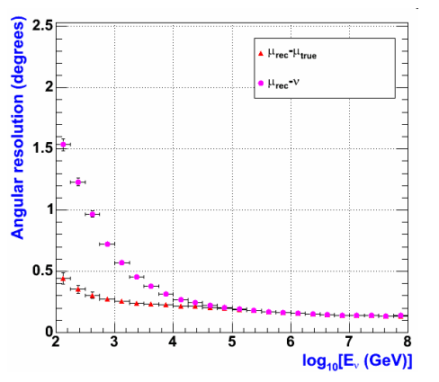
Detecting ν
Neutrino detection through CC interaction with production of a charged lepton
Neutrino astronomy requires the reconstruction of the neutrino direction and an estimate of the energy
For Eν >TeV, μ e ν are almost collinear.
In water:
ν_{μ}
μ
N
θ
X
μ reconstruction allows the measurement of the ν direction

Slide 30
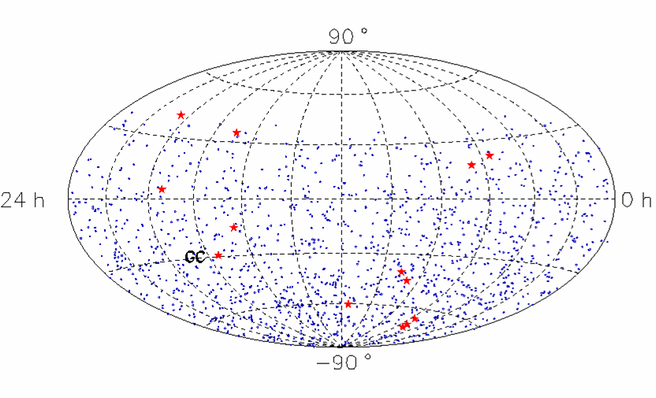
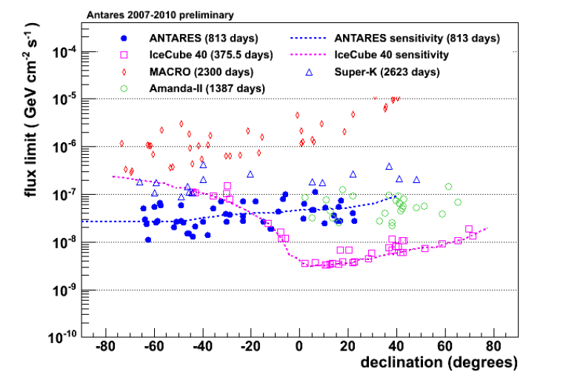
MACRO
(A=1000 m², T=5 y) results: no evidence!
Larger area experiments needed!

Slide 31
9.5 Upper Bounds on Neutrino Diffuse Fluxes
Upper bounds from UHE cosmic rays and γ diffuse flux can be established.
The first limit comes from the isotropic gamma ray background:
Φ_{ν} ≤ Φ_{γ}(MeV-GeV) O_{γ}
Atm νs
E² dΦ/dE < 10⁻⁶ GeV cm⁻² s⁻¹ sr⁻¹
Concerning cosmic rays, it can be established the following relationship:
Φ_{ν} ≤ Φ_{CR}(E_{CR}=f⁻¹E_{ν}) K O_{n} P
Waxman-Bahcall
Source transparent to HE neutrons (E_{n}~10¹⁹ eV)
Spectral shape up to GZK cut-off is dN/dE∝E⁻²
Mannheim-Protheroe-Rachen
There is no assumption about the opacity and the spectral indexes of the sources.
E² dΦ/dE < 4.5×10⁻⁸ GeV cm⁻² s⁻¹ sr⁻¹
E² dΦ/dE < 2×10⁻⁶ – 4.5×10⁻⁸ GeV cm⁻² s⁻¹ sr⁻¹
Oscillations reduce these limits in a factor two: 1:2:0 → 1:1:1
Notes:
The connection that we have pointed out between neutrinos and cosmic rays and high energy photons also provides a way to set upper bounds in the expected neutrino flux. On the one hand, neutrino production from charged pions has to be accompanied, as explained, by high energy photons from neutral pion decay, is such a way that the approximated equal luminosities are expected for both cases. Most of the photon luminosity should be in the MeV-GeV regime, due to the development of electromagnetic cascades. This sets a limit indicated here.
On the other hand, a similar expression can be derived with the cosmic ray flux. In this relationships we have had to add the opacity and propagation factors to obtain the transform the emission fluxes in observable luminosities.
Using this idea, Waxman and Bahcall set an upper bound more restrictive than the previous one. In the derivation of their limit, some additional hypothesis are made: the sources are assumed to be transparent to HE neutrons and emit with a spectral index equal to 2. This result is important because it is a reference for neutrino astronomy.
Later, Mannheim, Protheroe and Rachen calculated a more general upper bound, in which no assumption about the spectral index or the source opacity is assumed. For opaque sources the limit is set by gamma-rays. The limit of transparent sources is this one, and intermediate opacities give intermediate limits.
(The limits they obtain range between the line set by gamma-rays, for opaque sources, to this one, for transparent sources.)
Two remarks have to be made concerning these upper bounds. Firstly, that these limits only apply to extra-Galactic sources, and secondly, that when neutrino oscillations are included, they become a factor two lower.

Slide 32
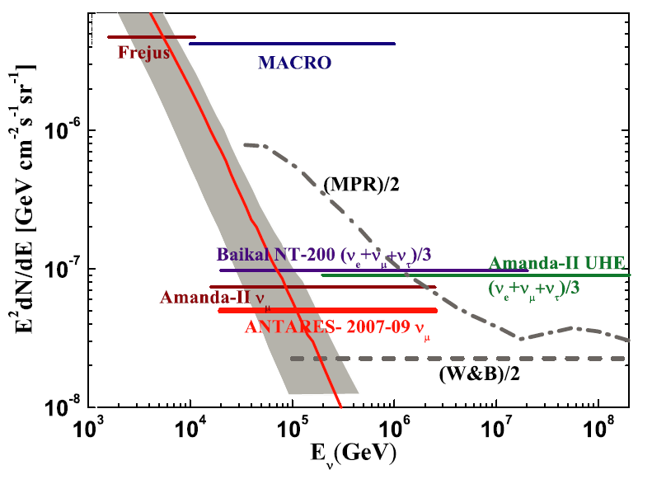
Search for a diffuse flux

Slide 33
9.6 The neutrino telescope projects
IceCube (South Pole)
Km3 (Mediterranean Sea)
- ANTARES (subproject)
  - NEMO (subproject)

Slide 34
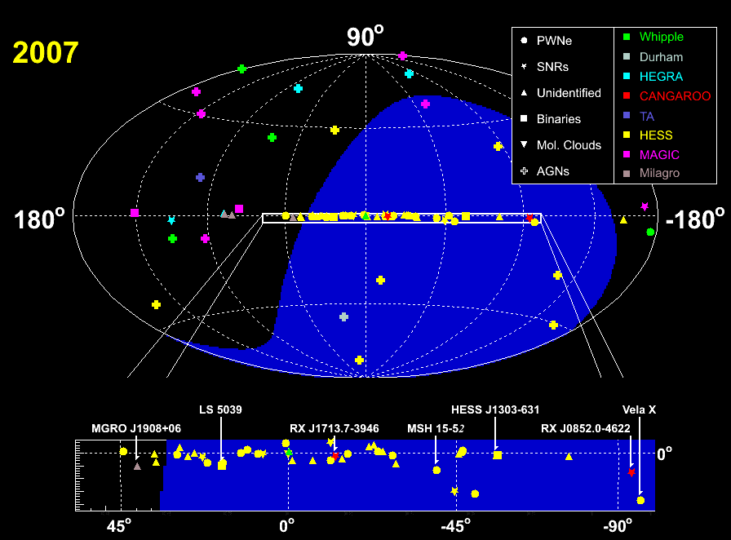
Sky map for NTs
Polo Sud
Mediterraneo
Jim Hinton
ICRC 2007

Slide 35
Neutrino-induced muons form cosmic sources in a km³ detector
Diffuse Flux
“UHE” (GZK): few / year ?
Diffuse, from GRB: (Waxman) 20 / year
Diffuse, from AGN (thin): (Mannheim) few / year
“ “ (thick): >100 / year
Point sources
GRB (030329): (Waxman) 1÷10 / burst
AGN (3C279): (Dermer) few / year
galactic SNR (Crab-like): (Protheroe ) few / year ?
Galactic Microquasars :(Distefano ) 1 ÷ 100 / year

Slide 36
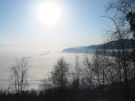

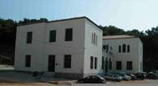
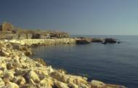
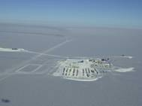
Neutrino telescopes
BAIKAL
NESTOR
Mediterranean
km³
DUMAND
ANTARES
NEMO
AMANDA
ICECUBE

Slide 37
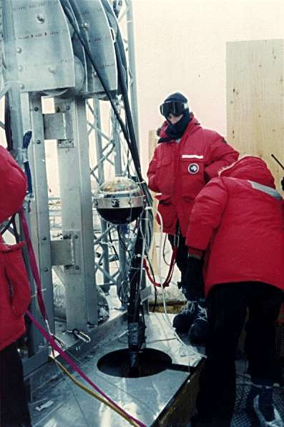

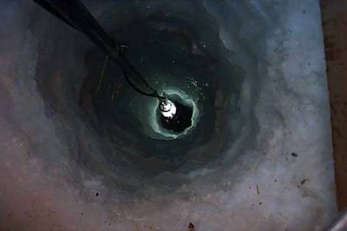
Difference between ice…
?

Slide 38
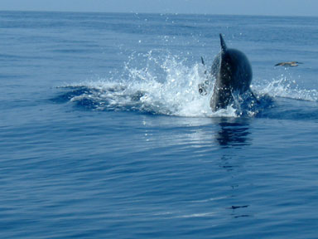
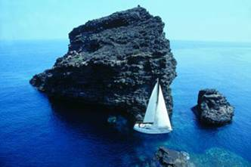

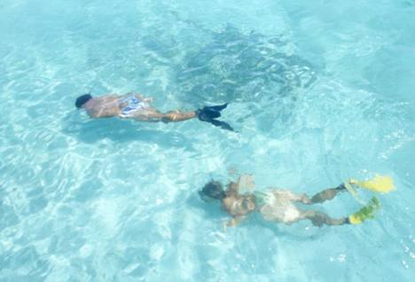
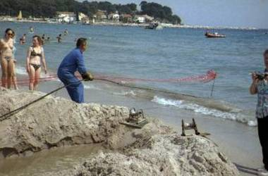
… and Mediterranean water

Slide 39
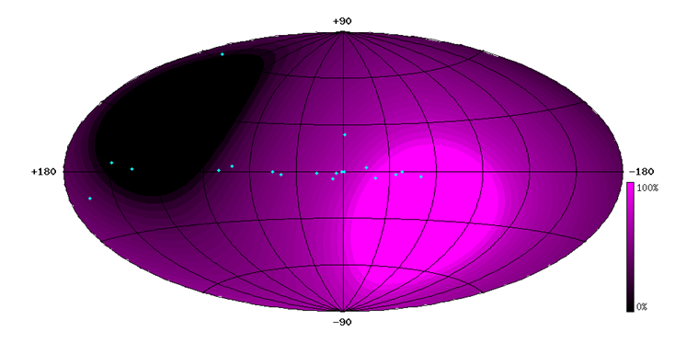

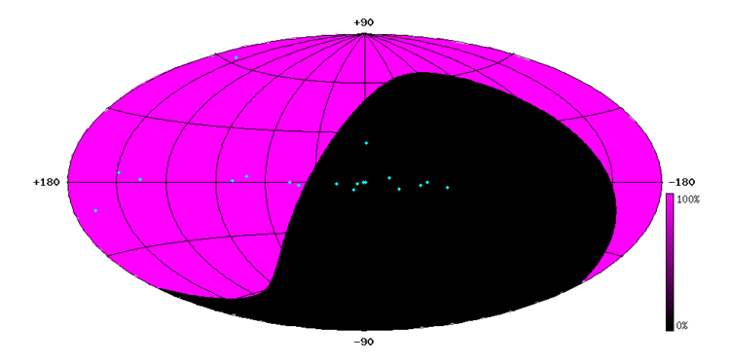
i) Sky View
Mediterranean Sea
43º North
2/3 of time: Galactic Centre
0.5 π sr instantaneous common view
1.5 π sr common view per day
AMANDA/IceCube
South Pole
Notes:
Dateien
Dateien

Slide 40
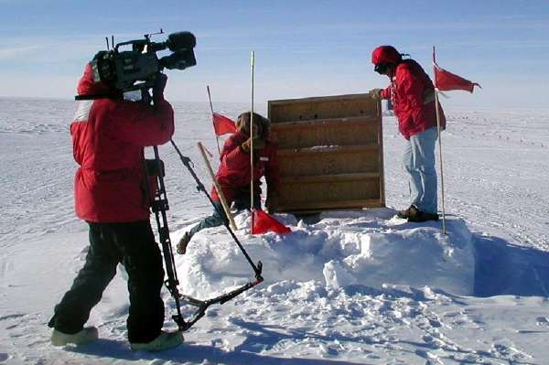
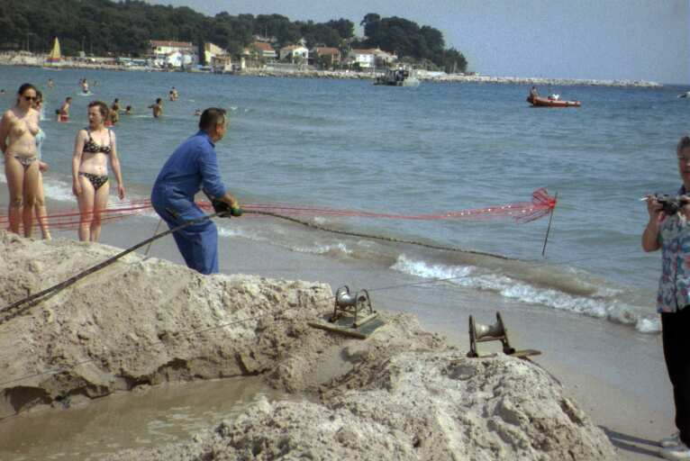
ii) Logistics
Notes:
Dateien
Dateien

Slide 41
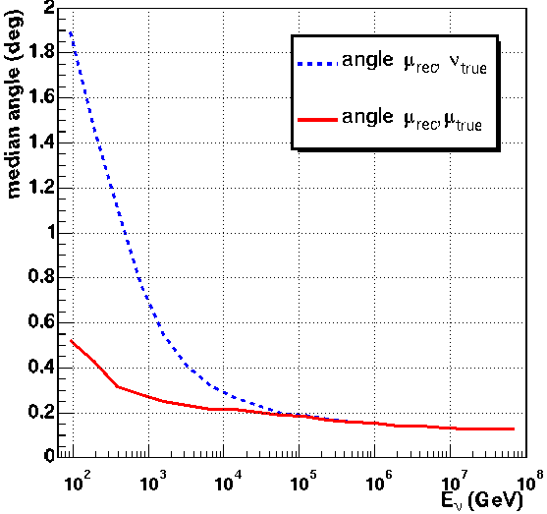
iii) Medium optical properties
Il mezzo assorbe e diffonde i fotoni. Ciò diminuisce il volume sensibile e la precisione nella ricostruzione
Ghiaccio: maggiore lunghezza di assorbimento → miglior V_{PMT}
Acqua: minore lunghezza di diffusione → migliore ricostruzione
μ
ν
Figura: ANTARES MC

Slide 42
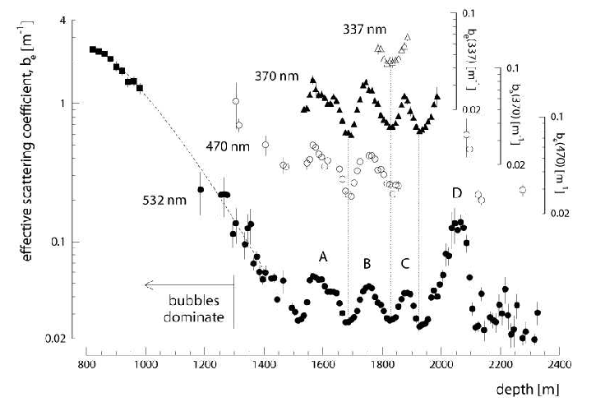
(…ghiaccio)
Coefficiente di diffusione (1/L_{diff}) per il ghiaccio. Occorre andare oltre 1400 m per evitare le bolle d’aria. Diversi picchi a diverse profondità dovuti a diversi tipi di polveri

Slide 43


iv) Background (water)
Bioluminescence =
Bursts from macroorganismes
(strongly affected by current velocity)
⁴⁰K decays (rate ~50 kHz)

Slide 44


Life in the deep sea (ANTARES)
  Commercial IR Video Camera in “self triggering mode”
Un po’ il sabato sera!
C’è vita negli abissi del mare?
14-01-2008 floor1

Slide 45


v) OM positioning
(water)
Hydrophones + sensors
tiltmeter/compass
z
height in m
P
i
r
zenith angle Θ
i
sea current v
F
i
Autonomous
Transponder
displacement in m

Slide 46

IceCube at the South Pole
Rivelatore in fase di costruzione in Antartide:
- 80 stringhe (60 PMT/stringa)
- 4800 10” PMT (verso il basso)
- 125 m distanza tra stringhe
- 16 m distanza tra PMT sulla stringa
- Volume istrumentato: 1 km3
- Completed (2012)

Slide 47


The ANTARES Collaboration
NIKHEF,
Amsterdam
Utrecht
KVI Groningen
NIOZ Texel
University of Erlangen
Bamberg Observatory
ITEP,Moscow
Moscow State Univ
ISS, Bucarest
IFIC, Valencia
UPV, Valencia
UPC, Barcelona
7 countries
29 institutes
~150 scientists+engineers
CPPM, Marseille
DSM/IRFU/CEA, Saclay
APC, Paris
LPC, Clermont-Ferrand
IPHC (IReS), Strasbourg
Univ. de H.-A., Mulhouse
IFREMER, Toulon/Brest
C.O.M. Marseille
LAM, Marseille
GeoAzur Villefranche
University/INFN of Bari
University/INFN of Bologna
University/INFN of Catania
LNS – Catania
University/INFN of Pisa
University/INFN of Rome
University/INFN of Genova
47
Notes:
M. Spurio- ANTARES
47

Slide 48





The site
La Seyne sur Mer

Slide 49



12 lines
25 storeys / line
3 PMTs / storey
900 PMTs
a storey
14.5 m
350 m
40 km to
shore
100 m
2500m depth
Junction
Box
~70 m
Anchor/line socket
Submarine links
© F. Montanet

Slide 50



Deployment of a line
DP boat « Castor 02 »
Line positioning on sea bed within 1m
7 hours of operations
9

Slide 51



Line connection by ROV
ROV «VICTOR 6000» from IFREMER
ODI link equipped with
wet mateable connector (4 optical, 2 electrical contacts)
Line connection
Junction box connection
10

Slide 52



ANTARES milestones
1996: birth of Antares
1996-2000: R&D
  Site measurements (optical background, fouling,
  absorption length, sea current,…)with autonomous lines
  Demonstrator line in 2000
2001-2003: Prototype lines
  Main Electro-optical cable in 2001
  Junction Box in 2002
  Prototype Sector Line (PSL) &
  Mini Instrumentation Line (MIL) in 2003
2004-2008: construction of the 12 lines detector
2007- 2013…: detector operation
Autonomous line
Demonstrator line
Cable installation
Junction Box
3

Slide 53




Optical background
bursts
baseline
Baseline:
⁴⁰K decays + bacteria luminescence
Bioluminescence bursts:
Animal species which emit light by flashes, spontaneous or stimulated around the detector.

Slide 54


Event Display: Atmospheric Muons
height
Example of a reconstructed down-going muon, detected in all 12 detector lines:
time

Slide 55


Event Display: Neutrino-induced muon
height
Example of a reconstructed up-going muon (i.e. a neutrino candidate) detected in 6/12 detector lines:
time

Slide 56



Downgoing Muons (5-lines)
data
CORSIKA
QGSJET +NSU
MC uncertainty
Agreement within (substantial) theoretical + MC uncertainty
Main experimental errors stem from OM efficiency and acceptance and optical water properties (λ _{abs} λ_{scatt})
MUPAGE
data
CORSIKA
QGSJET +NSU
CORSIKA
QGSJET+Horandel

Slide 57



5 lines (2007): Depth vs. Intensity
Preliminary
Preliminary
2,5km
6km
See talk: M. Bazzotti, 8/7/09, HE340
Work on reducing systematics is ongoing

Slide 58



5 line data (2007): NEUTRINOS
p, α
ν_{μ}
p
ν_{μ}
γ
Preliminary
168 active days
168 upward events
(multi-line fit)
down
up
horizontal

Slide 59





The NEMO collaboration
INFN
Bari, Bologna, Catania, Genova, LNF, LNS,
Napoli, Pisa, Roma
Università
Bari, Bologna, Catania, Genova, Napoli,
Pisa, Roma “La Sapienza”
CNR
Istituto di Oceanografia Fisica, La Spezia
Istituto di Biologia del Mare, Venezia
Istituto Sperimentale Talassografico, Messina
Istituto Nazionale di Geofisica e Vulcanologia (INGV)
Istituto Nazionale di Oceanografia e Geofisica Sperimentale (OGS)
Istituto Superiore delle Comunicazioni e delle Tecnologie dell’Informazione (ISCTI)
More than 70 researchers from INFN and other italian institutes

Slide 60
The NEMO Site
Depths of 3500 m reached at 100 km from the shore
Optimal water optical properties (La ≈ 70 m @ λ = 440 nm)
Low optical backgroung from bioluminescence bacteria
Stable water characteristics
Low and stable deep sea water currents (3 cm/s avg., 10 cm/s peak)
In a six years activity the NEMO collaboration has selected a deep sea site offshore Capo Passero (Sicily) with optimal oceanographycal and environmental properties
The site has been proposed in january 2003 to ApPEC
as a candidate for the km3 intallation

Slide 61


The NEMO “tower”
Mechanical structures for the km³ studied in order to optimize the detector performance
Modular structure composed by a sequence of 15 m long storeys interconnected by tensioning cables. Full height 750 m.
Power and data cables are kept separated from the tensioning ones
Optical Modules
Electronics container

Slide 62
The NEMO Phase 2 project
A deep sea station on the Capo Passero site
OBJECTIVES
Realization of an underwater infrastructure at 3500 m on the CP site
Test of the detector structure installation procedures at 3500 m
Installation of a 16 storey tower
Long term monitoring of the site
INFRASTRUCTURE UNDER CONSTRUCTION
Shore station in Portopalo di Capo Passero
100 km electro optical cable
Underwater infrastructures
STATUS
Purchase of the electro-optical cable (>50 kW) under way
A building (1000 m²) located inside the harbour area of Portopalo has been acquired. It will be renovated to host the shore station
Project completion planned in 2008

Slide 63
View of the cable landing area
Shore Station

Slide 64


Icecube/
KM3
NEMO:Underwater
connections
Ocean Design
ENI Consortium: SAIPEM, SASP ENG., TECNOMARE INDUSTRIALE/SONSUB

Slide 65

KM3NeT
Consortium between the Institutes that developed and support the pilot projects in the Mediterranean
  40 Institutes from 10 EU Countries (Cyprus, France, Germany, Greece, Ireland, Italy, The Netherlands, Rumania, Spain, U.K.)
Large European Research Infrastructure, included in the ESFRI roadmap
Design Study project (under the 6th FP)
  3 year project started in 2006 funded by the EC for 9 M€
  Conceptual Design Report Published in 2008, TDR in 2009
Preparatory Phase project (under the 7th FP)
  3 year project started in 2008 funded by the EC for 5 M€
  Coordinated by INFN

Slide 66

KM3neT reference detector
Factor ~3 more sensitive than IceCube
  larger photo-cathode area
  better direction resolution
Study still needs refinements

Slide 67




Symmetry breaking mechanism
€
2400 m
3500 m
4500 m - 5100 m
Toulon
Capo Passero
Pylos

Slide 68
Summary
All calculations show that we need km3scale detectors for neutrino astronomy
Compelling scientific arguments for neutrino astronomy and the construction of large neutrino telescopes
It is essential to complement IceCube (South Pole) with a km3 scale neutrino telescope in Northern Hemisphere
Joint effort of ANTARES, NEMO and NESTOR to realize such a detector in the Mediterranean Sea
EU funded KM3NeT Design Study (2006–2009) is well on its way
Cost: order of 100-200 M€

